Slide 1
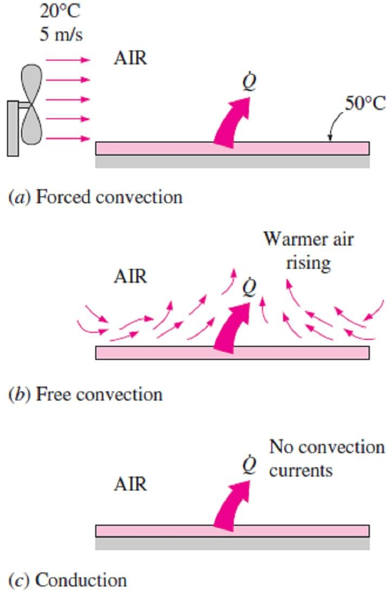
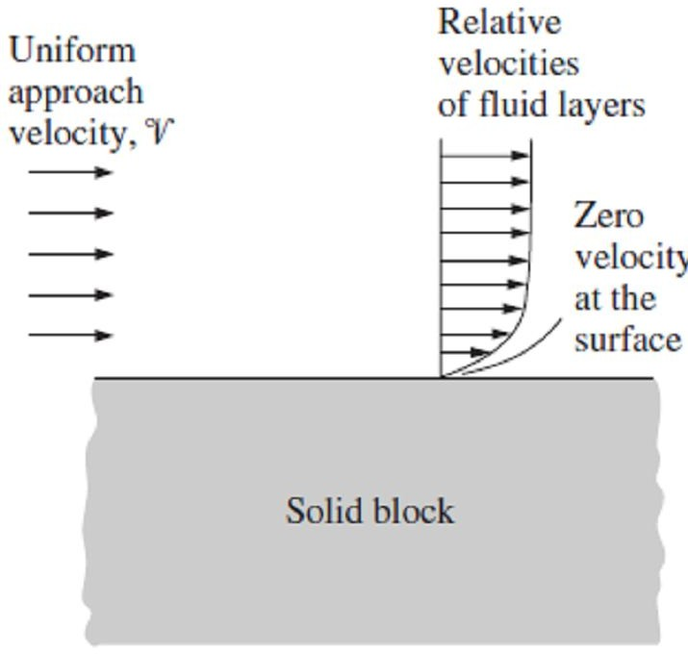
Chapter Six
Convection Heat Transfer
6.1- Introduction to Convection Heat Transfer
So far, we have considered conduction, which is the mechanism of heat transfer through a solid or a quiescent fluid. We now consider convection, which is the mechanism of heat transfer through a fluid in the presence of bulk fluid motion.
Note1- Convection is classified as natural (or free) and forced
convection, depending on how the fluid motion is initiated. In forced convection, the fluid is forced to flow over a surface or in a pipe by external means such as a pump or a fan. In natural convection, any fluid motion is caused by natural means such as the buoyancy effect, which manifests itself as the rise of warmer fluid and the fall of the cooler fluid.
Note2- Convection is also classified as external and internal, depending on whether the fluid is forced to flow over a surface or in a channel.
Note3- Conduction and convection are similar in that both
mechanisms require the presence of a material medium. Heat transfer through a liquid or gas occurs by conduction or convection, depending on the presence of any bulk fluid motion.
Heat transfer through a fluid is by convection in the presence of
Fig.(6.1) Heat transfer from a hot surface to the surrounding fluid by convection and conduction
bulk fluid motion and by conduction in the absence of it.
Therefore, conduction in a fluid can be viewed as the limiting case
of convection in the case of quiescent fluid as shown in Fig. (6.1).
6.1.1- Newton’s Law of Cooling and Convection Heat Transfer Coefficient
The rate of convection heat transfer is observed to be proportional to the temperature difference and is conveniently expressed by Newton’s law of cooling as;
q = h (T − T ) (W / m² ) ☹(6.1.a)
conv. s ∞
Or;
Q_{conv.} = h A_{s} (T_{s} − T∞ ) (W ) ☹(6.1.b)
Where; h = convection heat transfer coefficient, W/m²  C° A_{s} = heat transfer surface area, m²
T_{s} = temperature of the surface, C°
T∞ = temperature of the fluid sufficiently far from the surface, C°
Thus, according to its units, the convection heat transfer coefficient h can be defined as the rate of heat transfer between a solid surface and a fluid per unit surface area per unit temperature difference.
When a fluid is forced to flow over a solid surface that is nonporous (impermeable to the fluid), it is observed that the fluid in motion comes to a complete stop at the surface. That is, the fluid layer in direct contact with a solid surface “sticks” to the surface and there is no slip. In fluid flow, this phenomenon is known as the no-slip condition, and it is due to the viscosity of the fluid Fig.(6.2). A similar phenomenon occurs for the temperature. When two bodies at different temperatures are brought into contact, heat transfer occurs until both bodies assume the same temperature at the point of contact. Therefore, a fluid and a solid surface will have the same temperature at the point of contact. This is known as no- temperature-jump condition.
An implication of the no-slip and the no-temperature jump
conditions is that the local heat transfer from the solid surface to
the fluid layer adjacent to the surface is by pure conduction, sinceFig.(6.2) A fluid flowing over a stationary
the fluid layer is motionless, and can be expressed as;
surface comes to a complete stop at the surface because of the no-slip condition

Slide 2
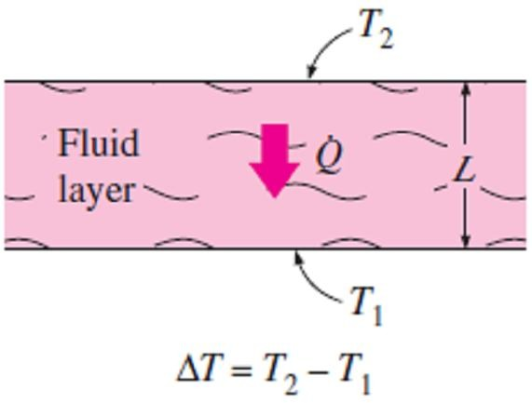
Chapter Six
Convection Heat Transfer
q = q = −k | ∂T | (W / m ² ) ...(6.2) y=0
conv . cond . fluid _{∂y}
where (∂T/∂y) _{y=0} represents the local temperature gradient at the surface. Note that convection heat transfer from a solid surface to a fluid is merely the conduction heat transfer from the solid surface to the fluid layer adjacent to the surface. Therefore, we can equate Eqs.[(6.1.a) & (6.2)] for the local heat flux to obtain the local convection heat transfer coefficient as follow; h = ^{− k fluid ( ∂T/ ∂y)y =0} (W / m ² ⋅ C □ ) ☹ (6.3.a) ^{x} T − T s ∞ If the values of local heat transfer coefficient is available along the entire surface of length L, the mean convection coefficient for the whole surface can be determined by integration along its length to be; h = ^{1 L} h dx (W / m ² ⋅C □ ) ☹ (6.3.b) m _{L} ∫₀ x 6.1.2- Nusselt Number In convection studies, it is common practice to nondimensionalize the governing equations and combine the variables, which group together into dimensionless numbers in order to reduce the number of total variables. It is also common practice to nondimensionalize the heat transfer coefficient h with the Nusselt number, defined as; Nu = ^{h Lc} ☹(6.4) k where k is the thermal conductivity of the fluid and L_{c} is the characteristic length of flow.
To understand the physical significance of the Nusselt number, consider a fluid layer of thickness L and temperature difference ΔT = T₂ - T₁, as shown in Fig.(6.3). Heat transfer through the fluid layer will be by convection when the fluid involves some motion and by conduction when the fluid layer is motionless. Heat flux (the rate of heat transfer per unit time per unit surface area) in either case will be; q_{conv.} = h ΔT ☹(6.5.a) q = ^{k ΔT} ☹(6.5.b) cond. _{L} Taking their ratio gives; ^{qconv.} = ^{h ΔT} = ^{h L} = Nu ☹(6.5.c) q_{cond .} k ΔT L k Therefore, the Nusselt number represents the enhancement of heat transfer through a fluid layer as a result of convection relative to conduction across the same fluid layer. The larger the Nusselt number, the more effective the convection. A Nusselt number of Nu = 1 for a fluid layer represents heat transfer across the layer by pure conduction. |  |  | Fig.(6.3) Heat transfer through a fluid layer of thickness L and temperature difference ΔT
6.2- Classification of Fluid Flows Convection heat transfer is the science that deals with the behavior of fluids at rest or in motion, and the interaction of fluids with solids or other fluids at the boundaries. There are many ways to classify the fluid flow problems, and below we present some general categories. 1- Viscous versus Unviscous Flow:- When two fluid layers move relative to each other, a friction force develops between them and the slower layer tries to slow down the faster layer. This internal resistance to flow is called the viscosity. So, Flows in which the effects of viscosity are significant are called viscous flows. If the effects of viscosity are very small in some flows, and neglecting those effects greatly simplifies the analysis without much loss in accuracy. Such idealized flows of zero- viscosity fluids are called frictionless or unviscous flows, where Prandtl number is too small Pr <<<1.

Slide 3
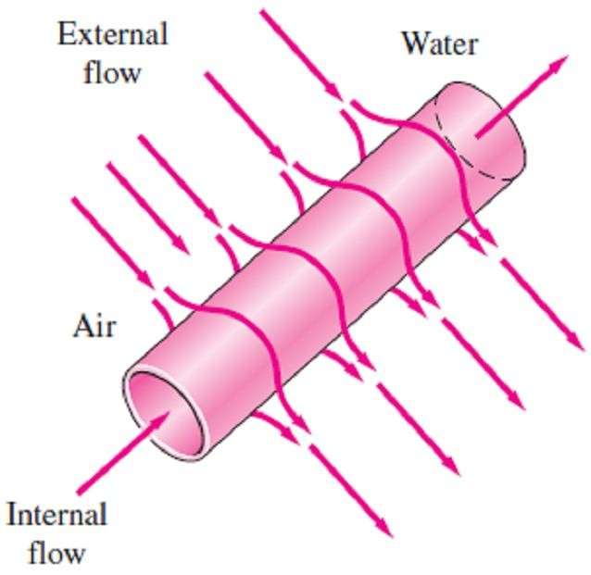
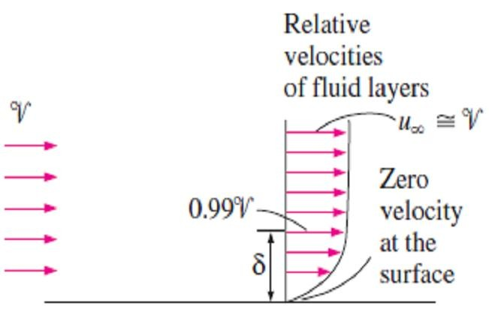
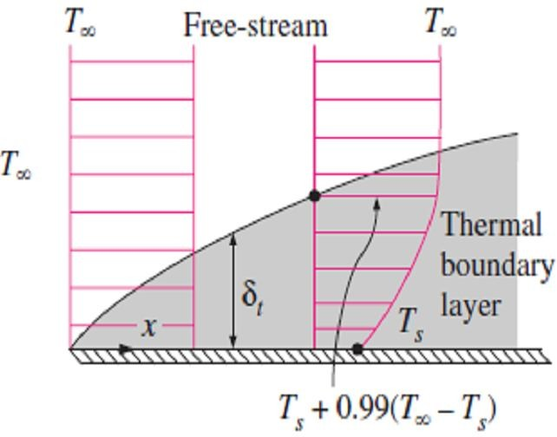
Chapter Six Convection Heat Transfer
Internal versus External Flow:- A fluid flow is classified as being internal and external depending on whether the fluid is forced to flow in a confined channel or over a surface. The flow of an unbounded fluid over a surface such as a plate, a wire, or a pipe is external flow. The flow in a pipe or duct is internal flow if the fluid is completely bounded by solid surfaces. Water flow in a pipe is internal flow, while air flow over an exposed pipe during a windy day is external flow Fig. (6.4).
Laminar versus Turbulent Flow:- Some flows are smooth and orderly
while others are random and disorderly. The highly ordered fluid motion characterized by smooth streamlines is called laminar. The flow of high- viscosity fluids such as oils at low velocities is typically laminar. The
highly disordered fluid motion that typically occurs at high velocities is Fig.(6.4) Internal flow of water
called turbulent. The flow of low-viscosity fluids such as air at high in a pipe and the external flow
velocities is typically turbulent.
of air over the same pipe
Natural (or Unforced) versus Forced Flow:- A fluid flow is said to be natural or forced, depending on how the fluid motion is initiated. In forced flow, a fluid is forced to flow over a surface or in a pipe by external means such as a pump or a fan. In natural flows, any fluid motion is due to a natural means such as the buoyancy effect.
Steady versus Unsteady (Transient) Flow:- The term steady implies
no change with time. The opposite of steady is unsteady, or transient.
One-, Two-, and Three-Dimensional Flows:- A flow field is best characterized by the velocity distribution, and thus a flow is said to be one-, two-, or three-dimensional if the flow velocity V varies in one, two, or three primary dimensions, respectively.
6.3- Boundary Layer Development 6.3.1- Velocity Boundary Layer
The presence of the plate is felt up to some normal distance δ from the
plate beyond which the free-stream velocity u∞ remains essentially unchanged. As a result, the x-component of the fluid velocity, u, will vary from 0 at y = 0 to nearly u∞ at y = δ as shown in Fig.(6.5). The region of the flow above the plate bounded by δ in which the effects of the viscous shearing forces caused by fluid viscosity are felt is called the velocity boundary layer. The boundary layer thickness, δ, is typically defined as the distance y from the surface at which u = 0.99u∞. The hypothetical line of u = 0.99u∞ divides the flow over a plate into two regions: the
boundary layer region, in which the viscous effects and the velocity ^{Fig.(6.5) The development of a}
changes are significant, and the unviscous flow region, in which the
boundary layer on a surface is due to the no-slip condition
frictional effects are negligible and the velocity remains essentially
constant.
6.3.2- Thermal Boundary Layer
The thermal boundary layer develops when a fluid at a specified temperature flows over a surface that is at a different temperature, as shown in Fig.(6.6), So if we consider the flow of a fluid at a uniform temperature of T∞ over an isothermal flat plate at temperature T_{s}. The fluid particles in the layer adjacent to the surface will reach thermal equilibrium with the plate and assume the surface temperature T_{s}. These fluid particles will then exchange energy with the particles in the
adjoining-fluid layer, and so on. As a result, a temperature profile will
Fig.(6.6) Thermal boundary
develop in the flow field that ranges from T_{s} at the surface to T∞ layer on a flat plate (the fluid is
sufficiently far from the surface. The flow region over the surface in
hotter than the plate surface)

Slide 4
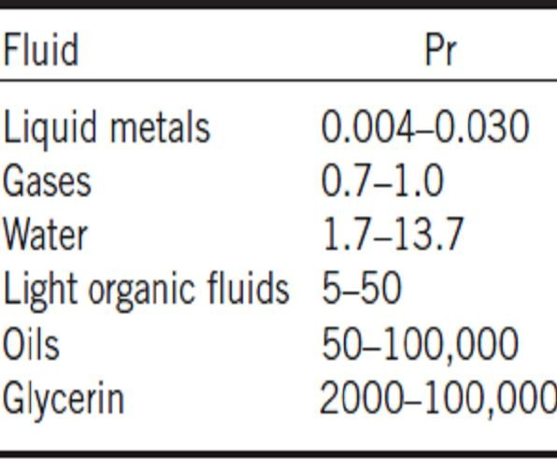
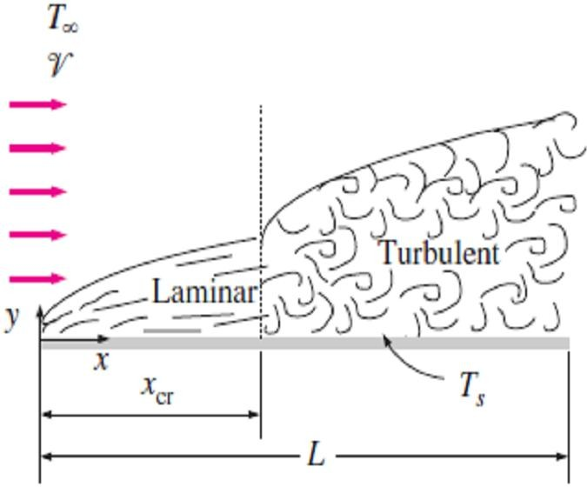
Chapter Six Convection Heat Transfer
which the temperature variation in the direction normal to the surface is significant is the thermal boundary layer. The thickness of the thermal boundary layer δ_{t} at any location along the surface is defined as the distance from the surface at which the temperature difference (T - T_{s}) equals 0.99(T∞ - T_{s}). Note that for the special case of Ts = 0, we have T = 0.99T∞ at the outer edge of the thermal boundary layer, which is analogous to u = 0.99u∞ for the velocity boundary layer.
6.3.3- Prandtl Number
The relative thickness of the velocity and the thermal boundary layers
Table (6.1) Typical ranges of
Prandtl numbers for common
is best described by the dimensionless parameter which is called Prandtl
number, and defined as;
_{Pr =} Molecular diffusivity of momentum ₌  ₌  Cp
☹(6.6)
Molecular diffusivity of heat  k
Note1- The Prandtl numbers of fluids range from less than 0.01 for liquid metals to more than 100,000 for heavy oils as shown in Table (6.1). Note that the Prandtl number is in the order of 10 for water.
Note2- Prandtl numbers of gases are about 1, which indicates that both momentum and heat dissipate through the fluid at about the same rate.
Note3- Heat diffuses very quickly in liquid metals (Pr << 1) and very slowly in oils (Pr >> 1) relative to momentum. Consequently the thermal
boundary layer is much thicker for liquid metals and much thinner for oils relative to the velocity boundary layer.
6.4- Forced Convection
6.4.1- External Forced Convection 6.4.1.1- Parallel Flow over Flat Plates
Consider the parallel flow of a fluid over a flat plate of length L in the
flow direction, as shown in Fig.(6.7). The x-coordinate is measured along the plate surface from the leading edge in the direction of the flow. The fluid approaches the plate in the x-direction with uniform upstream velocity V∞ and temperature T∞. The flow in the velocity boundary layer starts out as laminar, but if the plate is sufficiently long, the flow will become turbulent at a distance x_{cr} from the leading edge where the Reynolds number reaches its critical value for transition.
Fig.(6.7 Laminar and turbulent regions of the boundary layer during flow over a flat plate
6.4.1.1.a- Reynolds Number for Flow over Flat Plate
The transition from laminar to turbulent flow depends on the surface geometry, surface roughness, upstream velocity, surface temperature, and the type of fluid, among other things, and is best characterized by the Reynolds number. The Reynolds number at a distance x from the leading edge of a flat plate is expressed as;
Re
₌ V∞ x ₌ V∞ x
☹(6.7.a)
x
❍ 
The transition from laminar to turbulent is usually taken to occur at the
critical Reynolds number of;
Re = ^{V∞ xcr} = 5 ×10⁵ ☹(6.7.b)
cr
❍
Note- The value of the Reynolds number varies for a flat plate along the flow, reaching Re_{L} =V∞ L /v at the end of the plate.
112

Slide 5
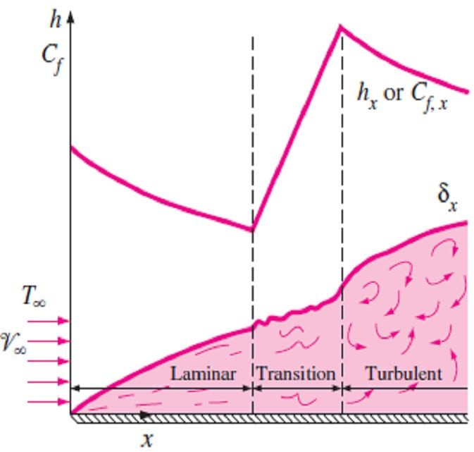
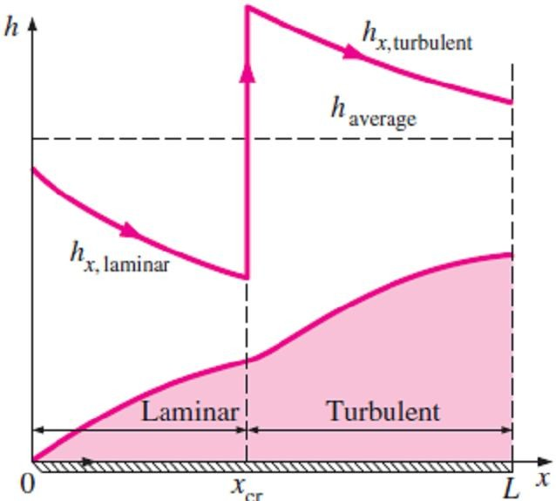
Chapter Six
Convection Heat Transfer
6.4.1.1.b- Heat Transfer Coefficient for Flow over Flat Plate
Heat transfer coefficient depends on the flow region on flat which is either laminar, transition or turbulent as shown in Fig.(6.8), also depends on the type of plate heating which is either by uniform plate temperature T_{s} (isothermal plate) or by uniform heat flux at the plate surface q_{w}. So, according to these limitations, we can compute the heat transfer coefficient and Nusselt number as follow;
1- Isothermal Flat Plate:
The local Nusselt number at a location x for laminar and turbulent flows over flat plate is computed as follow;
Laminar:
Nu =
h x
0.5 1/ 3
Pr >0.6
⎫
⎬
⎭
x
x
= 0.332 Re Pr ,
☹(6.8.a)
k
x
Re < 5×10
5
Turbulent:
x
Fig.(6.8) The variation of the local friction and heat transfer coefficients for flow over a flat plate
Nu = ^{hx x} = 0.0296 Re^{0.8} Pr^{1/ 3} ,
0.6 ≤ Pr ≤60
⎫
⎬
⎭
(6.8.b)
x x
5 7
k 5×10 ≤ Re ≤10
x
Note1- The local heat transfer coefficient h_{x} is proportional to Re ^{0.5} and thus to x ^{-0.5} for laminar flow. Therefore, h_{x} is infinite value at the leading edge (x = 0) and decreases by a factor of x ^{-0.5} in the flow direction, as shown in Fig.(6.8).
Note2- The local heat transfer coefficients h_{x} are higher in turbulent flow than it is in laminar flow.
Also, it reaches its highest values when the flow becomes fully turbulent, and then decreases by a factor of x ^{-0.2} in the flow direction, as shown in the Fig.(6.8).
Note3- The mean or average Nusselt number over the entire plate is determined by substituting the relations above into Eq.(6.3.b) and performing the integrations, We get;
Laminar:
Nu =
h L
0.5 1/ 3
Pr > 0.6
⎫
⎬
⎭
m
m
= 0.664 Re Pr ,
☹(6.9.a)
k
L
Re < 5×10
5
Turbulent:
L
Nu =
h L
0.8 1/ 3
0.6 ≤ Pr ≤60
⎫
⎬
m
m
= 0.037 Re Pr ,
☹(6.9.b)
L
7
k 5×10⁵ ≤ Re ≤ 10
⎭
L
Note4- The first relation gives the mean or average heat transfer coefficient for the entire plate when the flow is laminar over the entire plate. The second relation gives the mean or average heat transfer coefficient for the entire plate only when the flow is turbulent over the entire plate, or when the laminar flow region of the plate is too small relative to the turbulent flow region.
Note5- In some cases, a flat plate is sufficiently long for the flow to become turbulent, but not long enough to disregard the laminar flow region. In such cases, the average heat transfer coefficient over the entire plate is determined by performing the integration in Eq.(6.3.b) over the two parts;
h = ^{1 ⎛}⎜
∫
^{x}cr
h
dx +
∫
L
h
dx⎞⎟ (6.10.a)
m
x, la min ar
x, turbulent
L ⎝ ⎠
0
x
cr
Again taking the critical Reynolds number to be Re_{cr} = 5×10⁵ and performing the integrations in Eq.(6.10.a) after substituting the indicated expressions, the mean or average Nusselt number over the entire plate is;
Nu =
h L
0.8 1/ 3
0.6 ≤ Pr ≤60
⎫
⎬
⎭
m
m
=(0.037 Re − 871) Pr ,
(6.10.b)
Fig.(6.9) (h) for a flat plate with combined laminar and turbulent flow
k
L
7
5×10⁵ ≤ Re ≤ 10
L

Slide 6
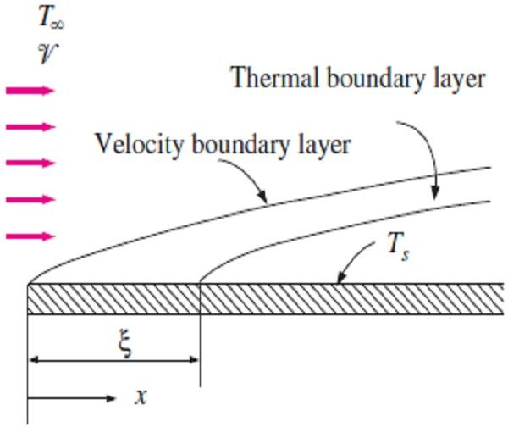
Chapter Six
Convection Heat Transfer
2- Isothermal Flat Plate with Unheated Starting Length:
So far we have limited our consideration to situations for which the entire plate is heated from the leading edge. But many practical applications involve surfaces with an unheated starting section of length ξ, as shown in Fig.(6.10), and thus there is no heat transfer for 0 < x < ξ. In such cases, the velocity boundary layer starts to develop at the leading edge (x = 0), but the thermal boundary layer starts to develop where heating starts (x = ξ). So if we have a flat plate whose heated section is maintained at a constant temperature (T = T_{s} constant for x > ξ), the local Nusselt numbers for both laminar and turbulent flows are
determined to be;
Laminar:
^{Nu}x ( For =0)
0.332 Re^{0.5} Pr^{1/ 3}
Fig.(6.10) Flow over a flat plate with an unheated starting length
Nu =
[1 − ( / x) ]
x
_{3/ 4} 1/ 3
☹(6.11.a)
x
_{3/ 4} 1/ 3 ⁼
[1 − ( / x) ]
Turbulent:
= [
Nu =
^{Nu}x ( For =0)
0.0296 Re^{0.8} Pr^{1/ 3}
☹(6.11.b)
[1 − ( / x) ]
x
x
9 /10
1/ 9
1 − ( / x) ^{9 /10} ]^{1/ 9}
Note1- The determination of the mean or average Nusselt number for the heated section of a plate requires the integration of the local Nusselt number relations above, which cannot be done analytically. Therefore, integrations must be done numerically. Thus, the numerical integration for the
average heat transfer coefficient will give;
Laminar:
2 [1 − ( / L)^{3 / 4} ]
1 −  / L
h_{m} =
^{h}x=L
☹(6.12.a)
Turbulent:
5 [1 − ( / L)^{9 /10} ]
4 (1 −  / L)
h_{m} =
^{h}x=L
☹(6.12.b)
Note2- The first relation gives the average heat transfer coefficient for the entire heated section of the plate when the flow is laminar over the entire plate, The second relation gives the average convection coefficient for the case of turbulent flow over the entire plate or when the laminar flow region is small relative to the turbulent region.
3- Uniform Heat Flux:
When a flat plate is subjected to uniform heat flux instead of uniform temperature, the local Nusselt number will be given by;
Laminar:
Nu =
h x
0.5 1/ 3
x
x
= 0.453 Re Pr
☹(6.13.a)
k
x
Turbulent:
Nu =
h x
0.8
1/ 3
x
x
= 0.0308 Re Pr
☹(6.13.b)
k
x
Note1- Correction for the effect of an unheated starting length may be made by using Eqs.[(6.13.a) & (6.13.b)] with Eqs.[(6.11.a) & (6.11.b)] as follow;
Laminar:
Nu =
^{Nu}x ( For =0)
0.453 Re^{0.5} Pr^{1/ 3}
☹(6.14.a)
[1 − ( / x) ]
x
_{3/ 4} 1/ 3
x
_{3/ 4} 1/ 3 ⁼
[1 − ( / x) ]

Slide 7
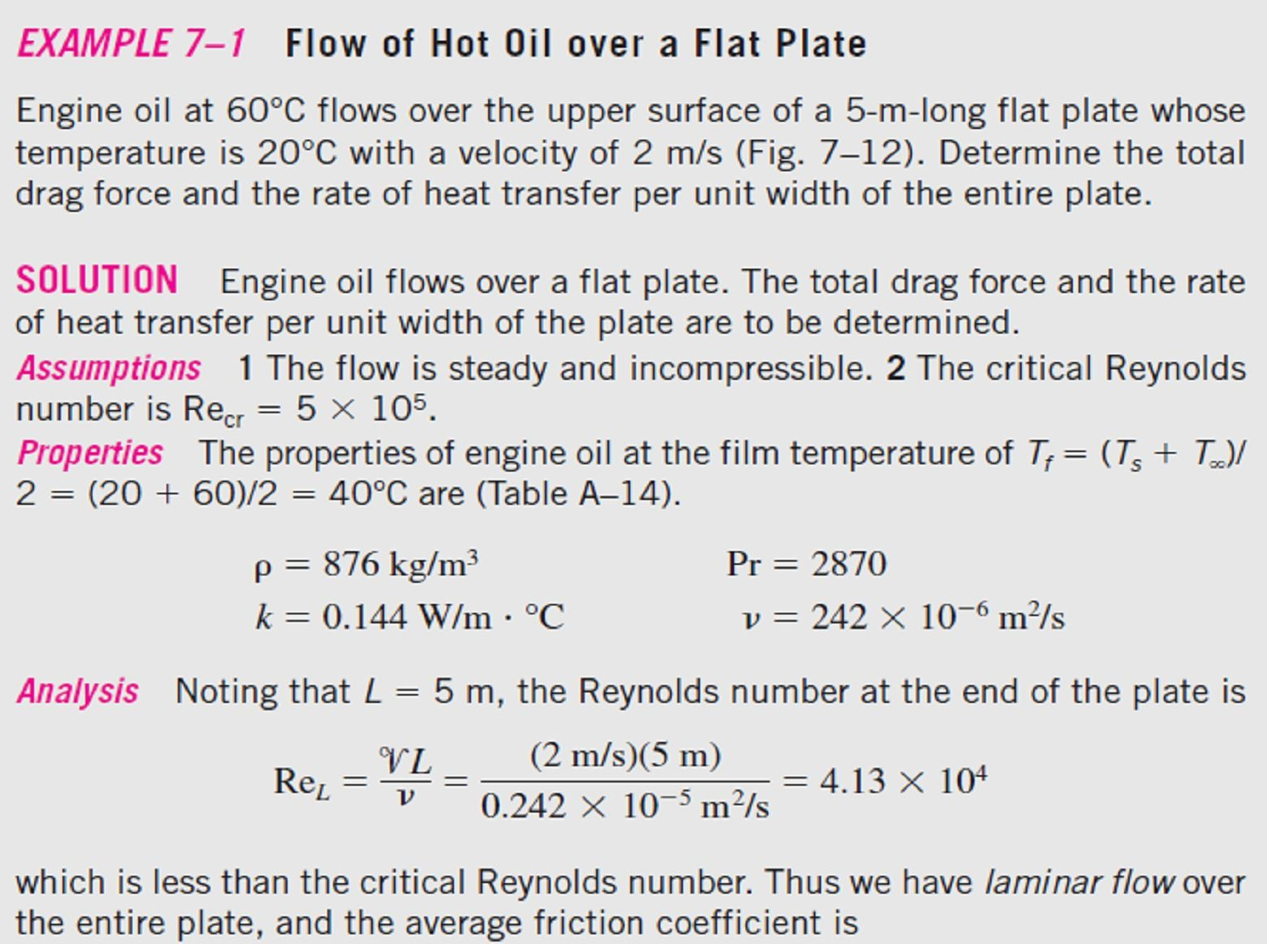
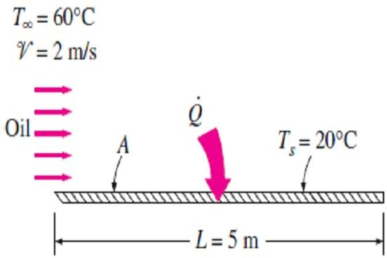
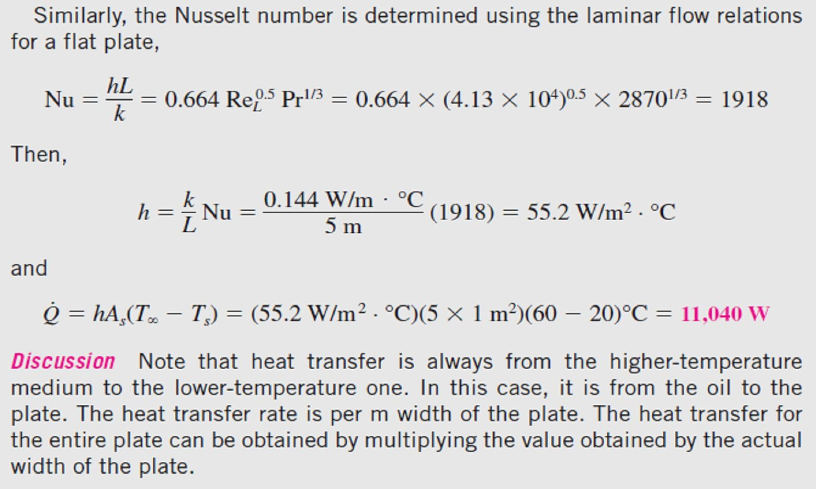
Chapter Six
Convection Heat Transfer
Turbulent:
= [
Nu =
^{Nu}x ( For =0)
0.0308 Re^{0.8} Pr^{1/ 3}
☹(6.14.b)
x
x
[  / x) ] ]
1/ 9
1 − ( 1 − ( / x) ^{9 / 10 1/ 9}
9 /10
Note2- When heat flux q_{s} is prescribed, the rate of heat transfer to or from the plate and the surface temperature at a distance x are determined from;
Q = q_{s} A_{s} …(6.15.a)
And;
q_{s} = h_{x}[T_{s} (x) −T∞ ] ⇒ T_{s} (x) = T∞ +
Where A_{s} is the heat transfer surface area.
q
s
☹(6.15.b)
h
x
6.1-
, Fig(6.11).
Fig.(6.11) Schematic for Example- 6.1
.

Slide 8
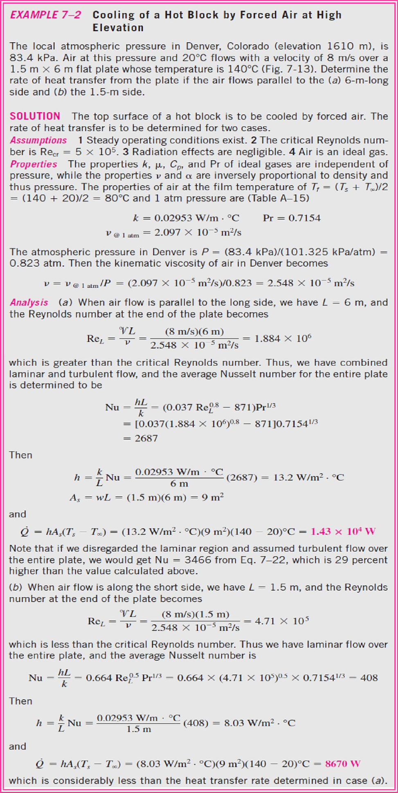
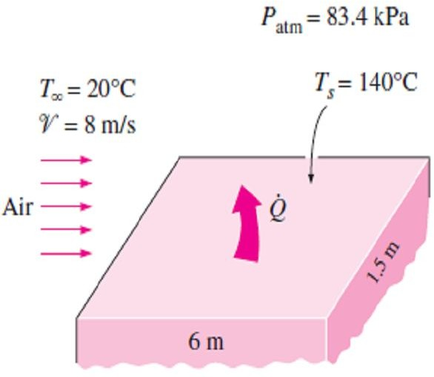
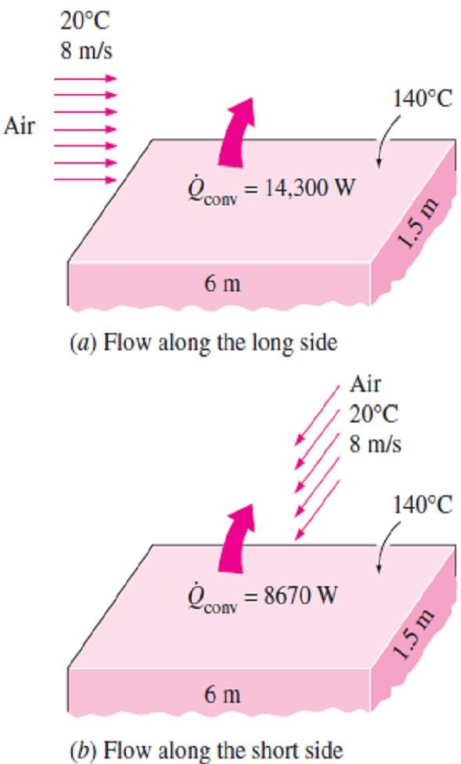
Chapter Six
Convection Heat Transfer
6.2-
Fig.(6.12).
Fig.(6.12) Schematic for Example- 6.2
Fig.(6.13) The direction of fluid flow can have a significant effect on convection heat transfer

Slide 9
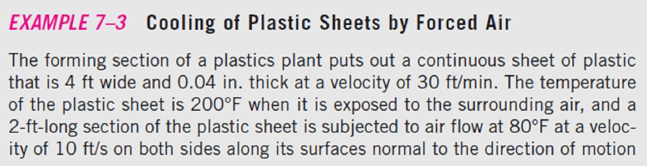
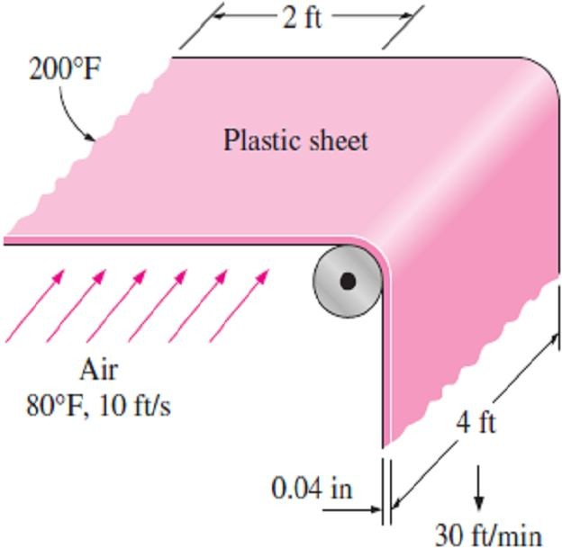
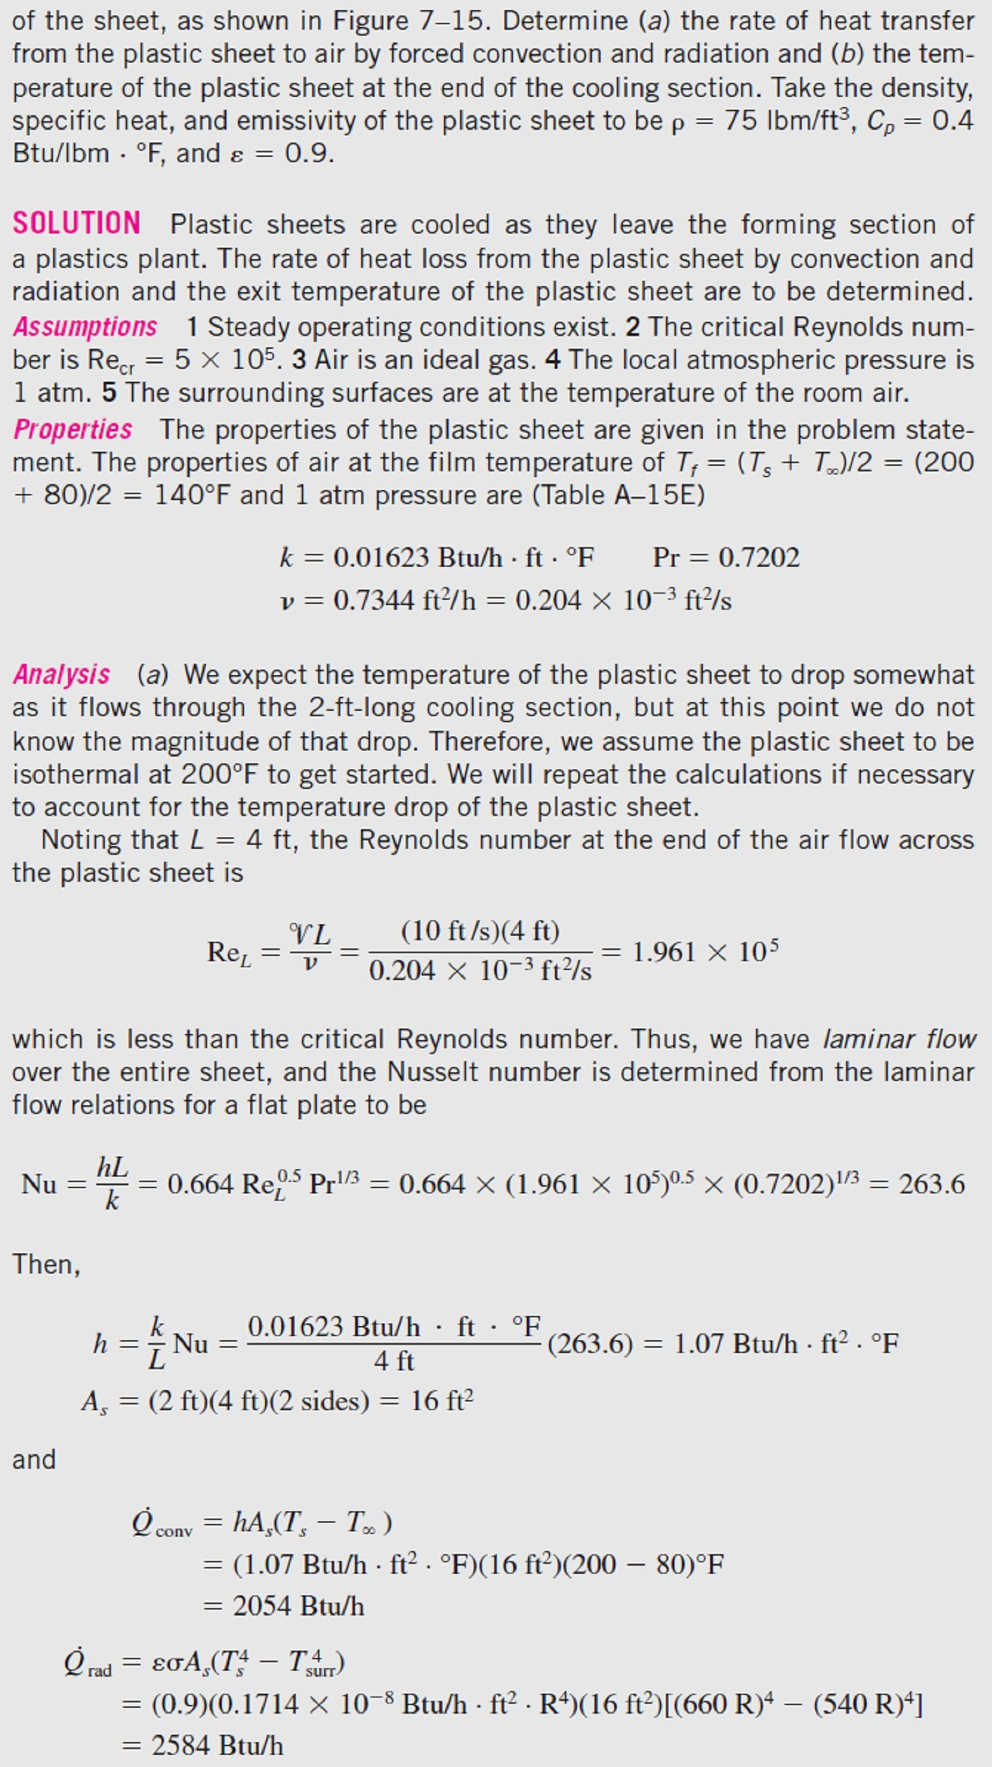
Chapter Six
Convection Heat Transfer
6.3-
Fig.(6.14).
Fig.(6.14) Schematic for Example- 6.3

Slide 10
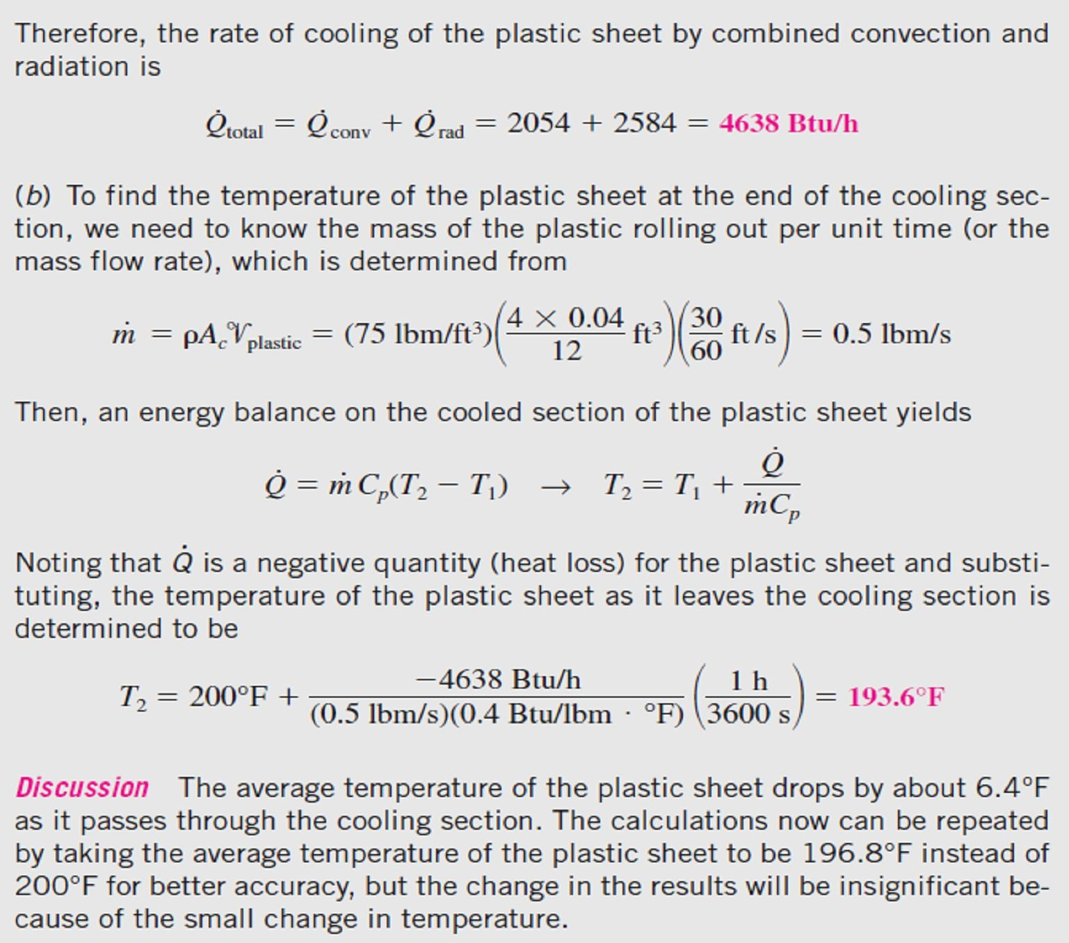
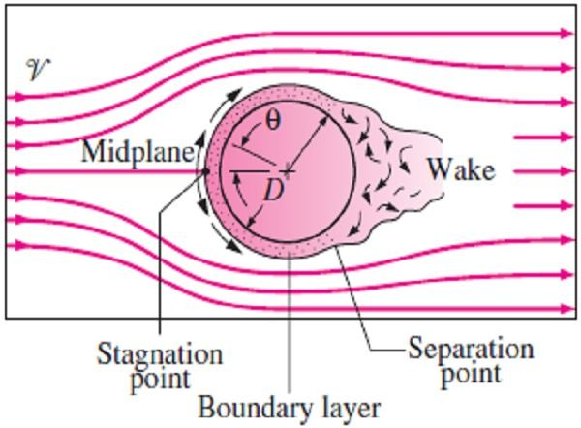
Chapter Six
Convection Heat Transfer
6.4.1.2- Flow across Cylinders and Spheres
Flows across cylinders and spheres are commonly encountered in practice. For example, the tubes in a shell-and-tube heat exchanger involve both internal flow through the tubes and external flow over the tubes, and both flows must be considered in the analysis of the heat exchanger.
6.4.1.2.a- Reynolds Number for Flow Across Cylinders & Spheres The characteristic length for a circular cylinder or sphere is taken to be the external diameter D. Thus, the Reynolds number is defined as;
Re = ^{V D} ☹(6.16)
■
where V is the uniform velocity of the fluid as it approaches the cylinder Fig.(6.15) Typical flow patterns
or sphere.
in cross flow over a cylinder
Note- The critical Reynolds number for flow across a circular cylinder or sphere is about Re_{cr} ≈ 2 × 10⁵. That is, the boundary layer remains laminar for about Re < 2 × 10⁵ and becomes turbulent for Re ≥ 2 × 10⁵.
6.4.1.2.b- Heat Transfer Coefficient for Flow Across Cylinders and Spheres
Flows across cylinders and spheres, in general, involve flow separation, which is difficult to handle analytically. Therefore, such flows must be studied experimentally or numerically. For cross flow over a cylinder we can use the following relation for the average Nusselt number;
h D 0.62 Re^{1/ 2} Pr^{1/ 3}
⎡
⎛ Re
4 / 5
⎞5 / 8 ⎤
^{Nu}cyl. ⁼
= 0.3 + _{1/ 4} ⎢1 + ⎜
⎟ ⎥ ☹(6.17.a)
⎥⎦
k
[1 + (0.4 / Pr)^{2 / 3} ]
⎢⎣
⎝ 282,000 ⎠
Where the fluid properties are evaluated at the film temperature T_{f} = (T∞ + T_{s})/2. For flow over a
sphere, we can use the following relation for the mean or average Nusselt number;
h D
= 2 + [0.4 Re^{1/ 2} + 0.06 Re^{2 / 3} ]Pr
⎛ 
⎞1/ 4
0.4
⎜ ⎟ ☹(6.17.b)
^{Nu}sph. ⁼
k
∞
⎝ s ⎠

Slide 11
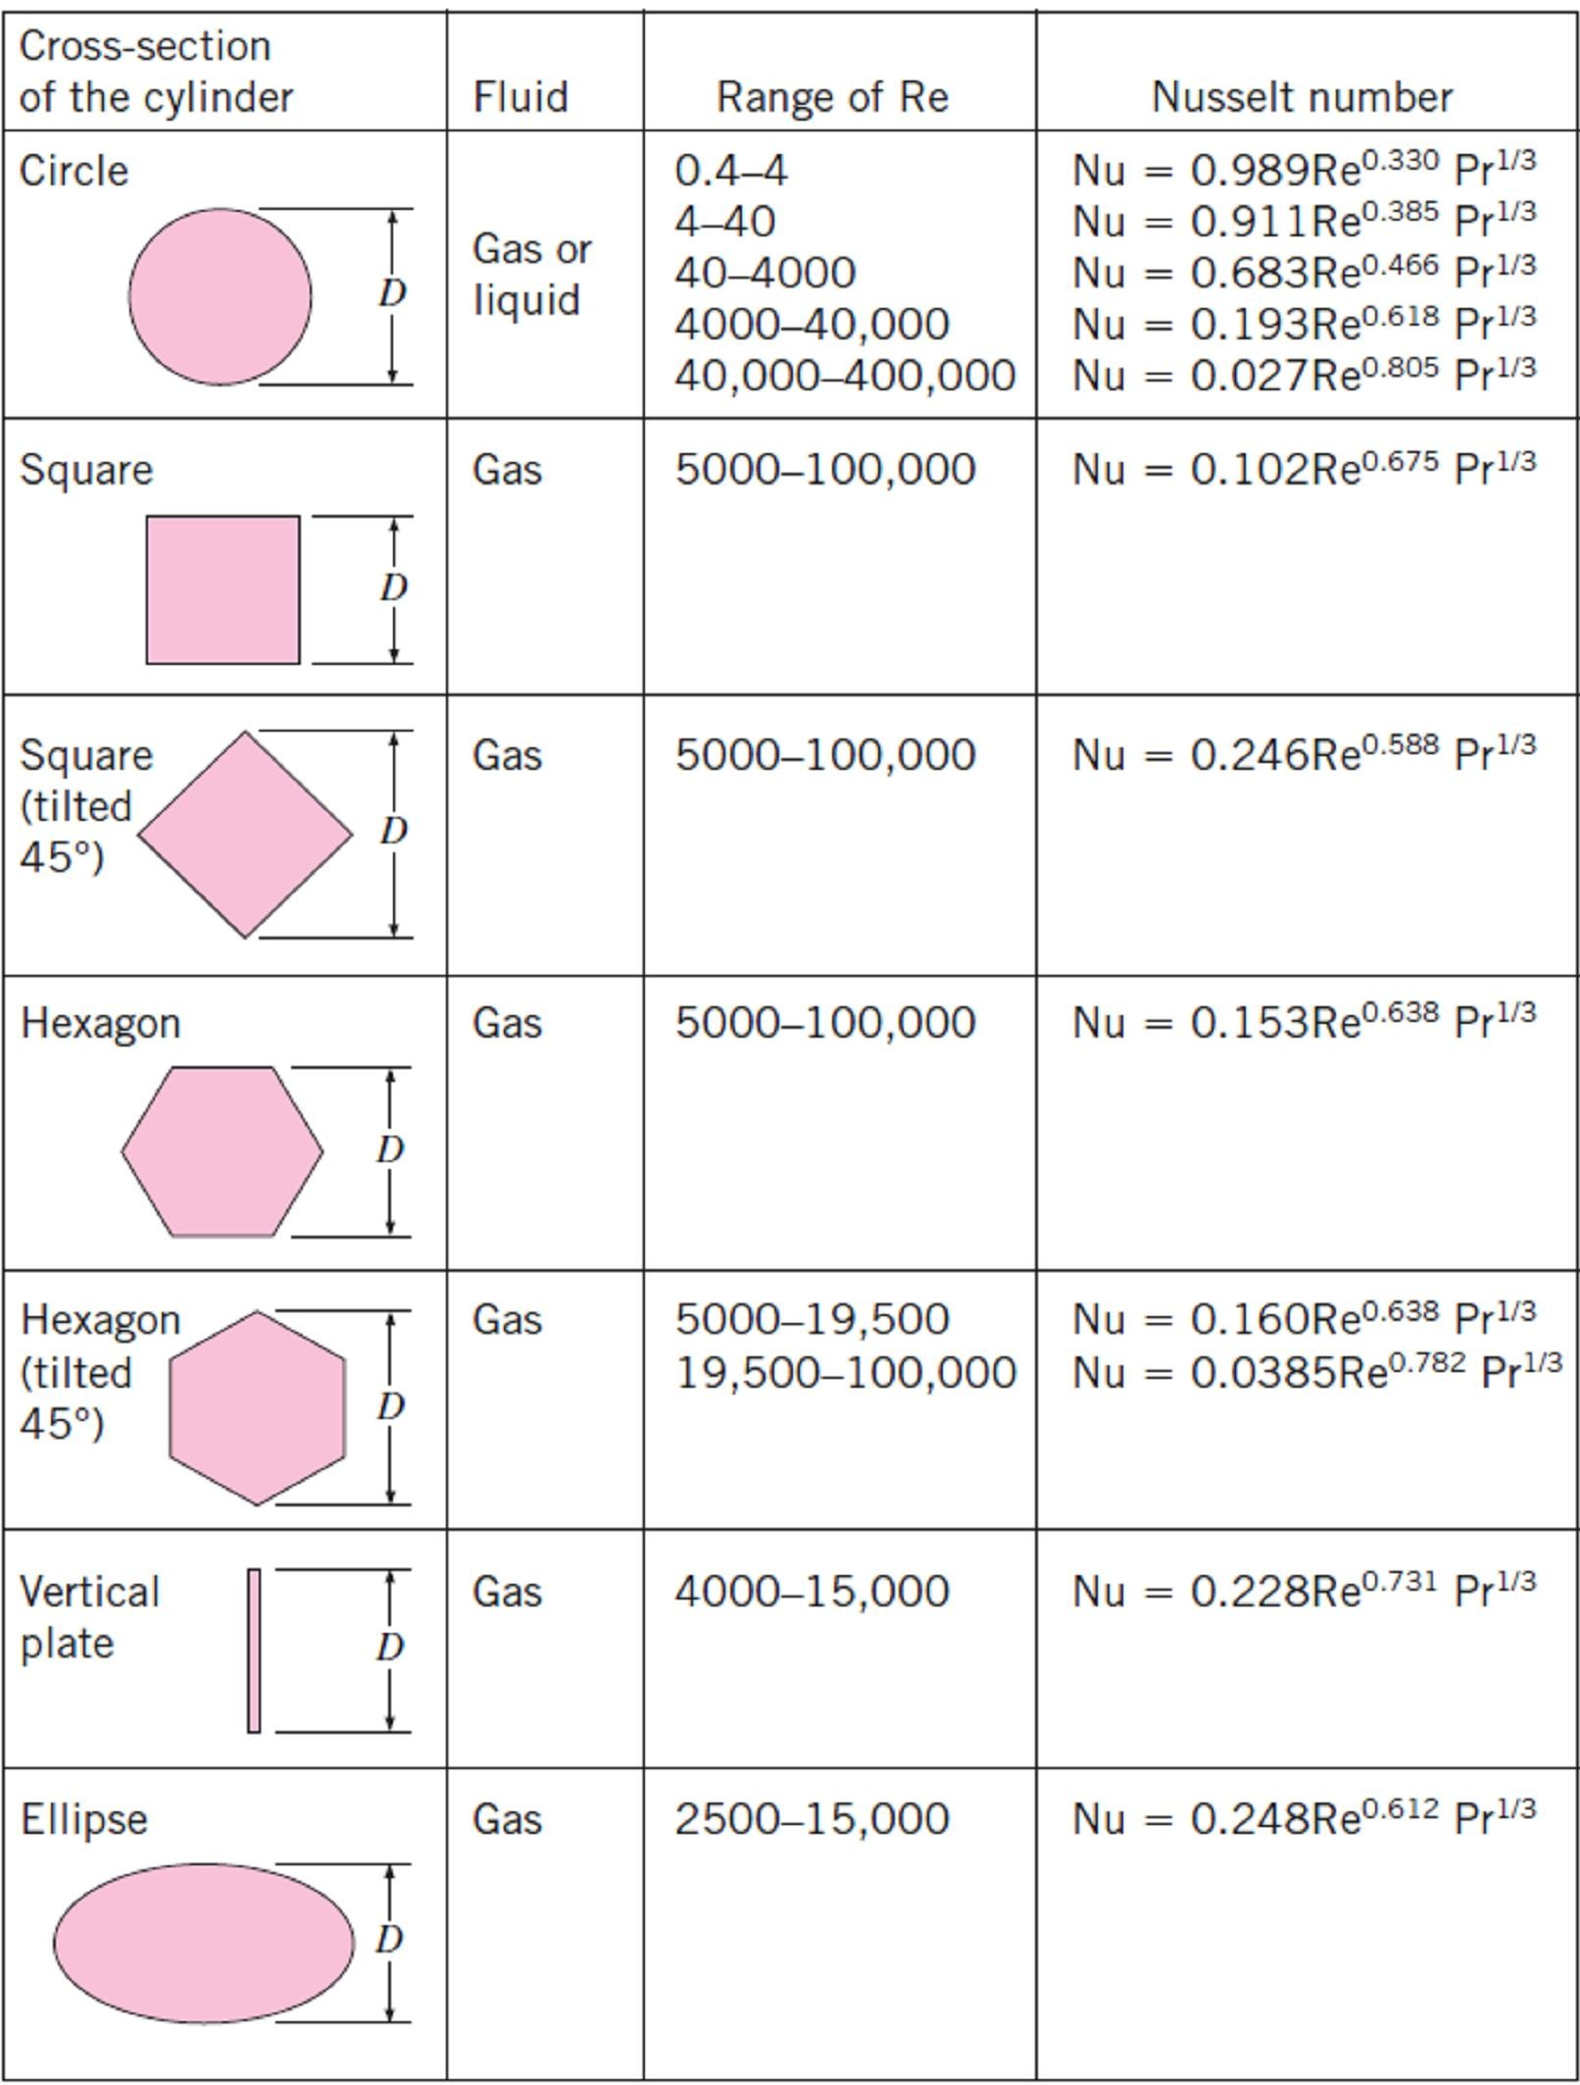
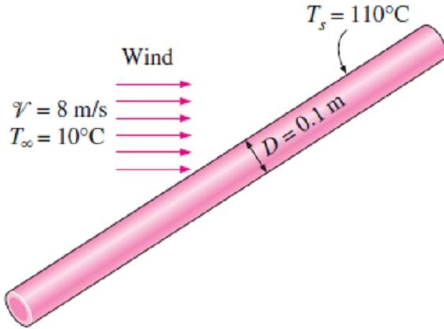
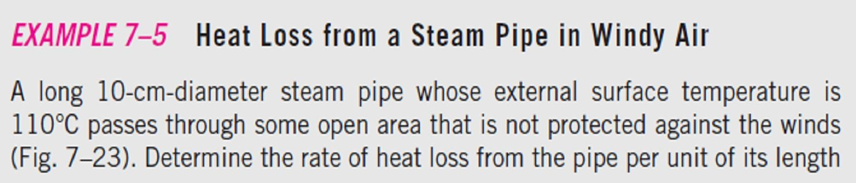
Chapter Six Convection Heat Transfer
which is valid for 3.5 ≤ Re ≤ 80,000 and 0.7 ≤ Pr ≤ 380. The fluid properties in this case are evaluated at the free-stream temperature T∞, except for μ_{s}, which is evaluated at the surface temperature T_{s}.
A general empirical form for the mean Nusselt number of flow across cylinders can be expressed as;
Nu = ^{h D} = C Re^{m} Pr^{n} ☹(6.18)
cyl .
■
where n = 1/3 and the experimentally determined constants C and m are given in Table (6.2) for circular as well as various noncircular cylinders.
Table (6.2) Empirical correlations for the average Nusselt number for forced convection
over circular and noncircular cylinders in cross flow
6.4-
Fig.(6.16).
Fig.(6.16) Schematic for Ex. 6.4

Slide 12
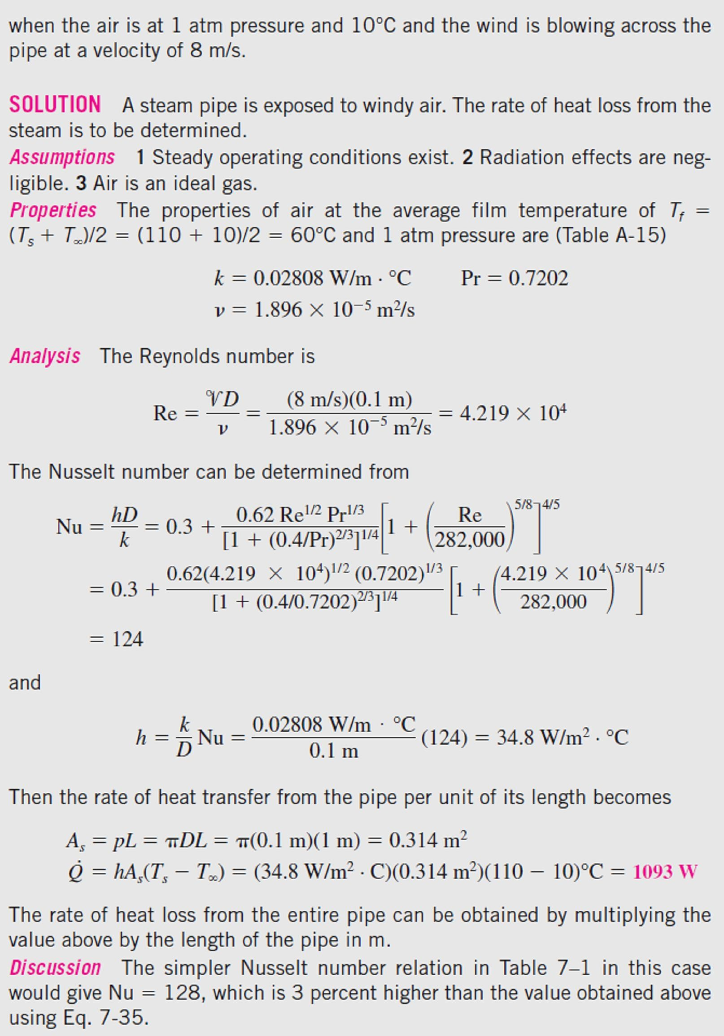
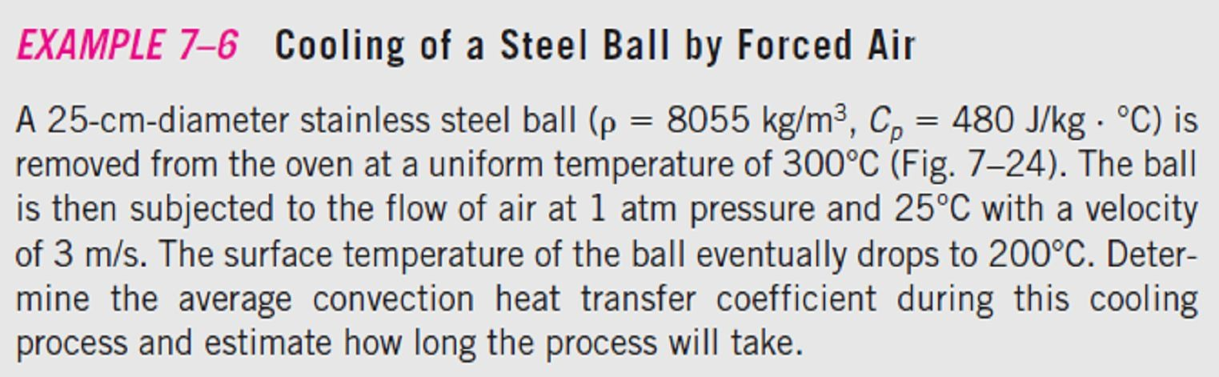
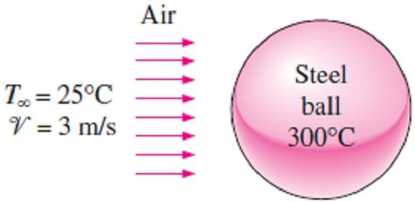
Chapter Six
Convection Heat Transfer
(6.2)
(6.17.a).
6.5-
Fig.(6.17).
Fig.(6.17) Schematic for Example- 6.5

Slide 13
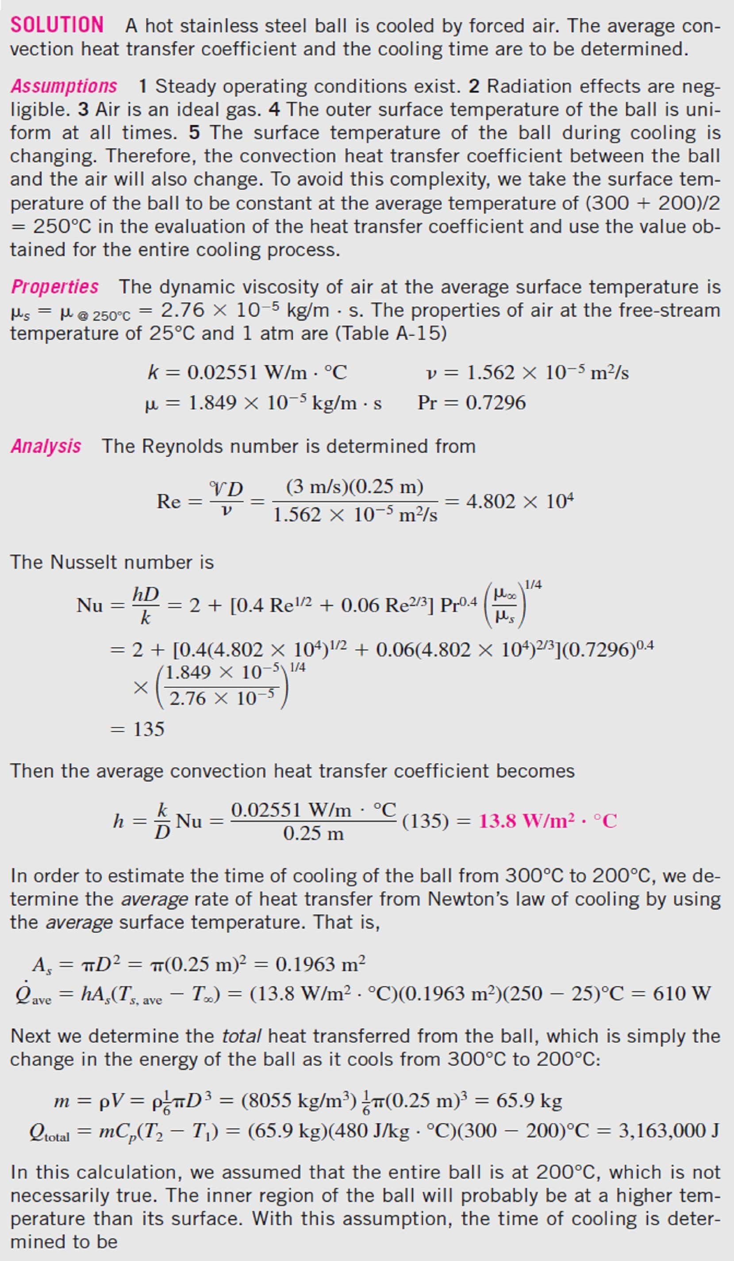

Chapter Six
Convection Heat Transfer

Slide 14
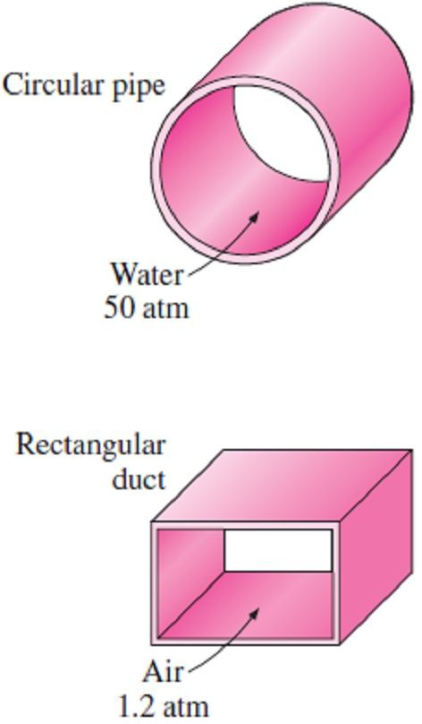
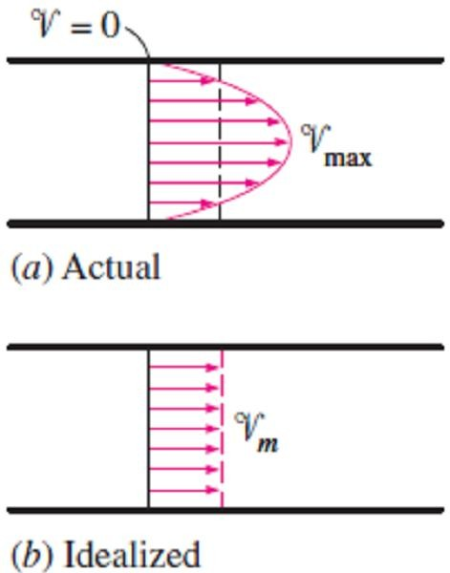
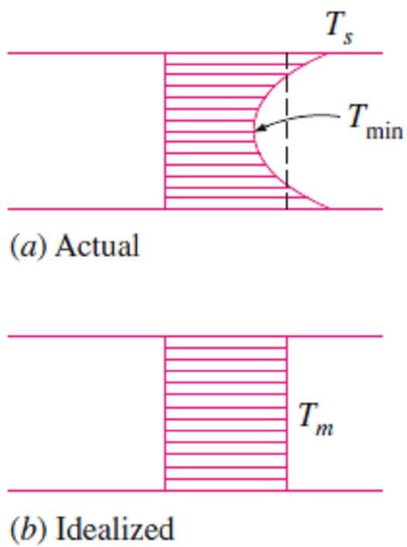
Chapter Six
Convection Heat Transfer
6.4.2- Internal Forced Convection
You have probably noticed that most fluids, especially liquids, are transported in circular pipes. This is because pipes with a circular cross section can withstand large pressure differences between the inside and the outside without undergoing any distortion. Noncircular pipes are usually used in applications such as the heating and cooling systems of buildings where the pressure difference is relatively small and the manufacturing and installation costs are lower Fig. (6.18). The terms pipe, duct, tube, and conduit are usually used interchangeably for flow sections. In general, flow sections of circular cross section are referred to as pipes (especially when the fluid is a liquid), and the flow sections of noncircular cross section as ducts (especially when the fluid is a gas). Small diameter pipes are usually referred to as tubes. Given this uncertainty, we will use more descriptive phrases (such as a circular pipe or a rectangular duct) whenever necessary to avoid any misunderstandings.
6.4.2.1- Mean Velocity and Mean Temperature
Fig.(6.18) Circular pipes can
withstand large pressure
In external flow, the free-stream velocity served as a convenient reference _{differences between the inside}
velocity for use in the evaluation of the Reynolds number. In internal flow, and the outside without there is no free stream and thus we need an alternative. The fluid velocity in a ^{undergoing any distortion, but} tube changes from zero at the surface because of the no-slip condition, to a ^{the noncircular pipes cannot} maximum at the tube center. Therefore, it is convenient to work with an
average or mean velocity V_{m}, which remains constant for incompressible
flow when the cross sectional area of the tube is constant. The value of the mean velocity V_{m} in a tube is determined from the requirement that the conservation of mass principle be satisfied Fig. (6.19). That is;
∫
∫
A
V (r, x) d A
c
m = V A = V (r, x) d A ⇒ V =
c
☹(6.19)
m c
A
c m
❒ A_{c}
c
where m• is the mass flow rate, ρ is the density, A_{c} is the cross sectional area,
and V(r, x) is the velocity profile.
Fig.(6.19) Actual and idealized
When a fluid is heated or cooled as it flows through a tube, the temperature
velocity profiles for flow in a
of the fluid at any cross section changes from T_{s} at the surface of the wall to tube (the mass flow rate of the
some maximum (or minimum in the case of heating) at the tube center. In fluid is the same for both cases)
fluid flow it is convenient to work with an average or mean temperature T_{m} that remains uniform at a cross section. Unlike the mean velocity, the mean temperature T_{m} will change in the flow direction whenever the fluid is heated or cooled.
∫ ∫

E _{fluid} = m Cp T_{m} =
Cp T (r, x) dm =  Cp T (r, x)V (r, x) d A
m
•
A
c
∫
❒ T (r, x)V (r, x) d A
c
∴ T =
A
c
☹(6.20)
m
c
_{m}•
where Cp is the specific heat of the fluid.
Note1- The mean temperature T_{m} of a fluid changes during heating or cooling.
Note2- The fluid properties in internal flow are usually evaluated at the bulk
_{mean} Fig.(6.20) Actual and idealized
mean fluid temperature, which is the arithmetic average of the temperatures at the inlet and the exit. That is, T_{b} = (T_{m, inlet} + T_{m, exit}) /2.
temperature profiles for flow in
a tube (the rate at which energy is transported with the fluid is the same for both cases)

Slide 15
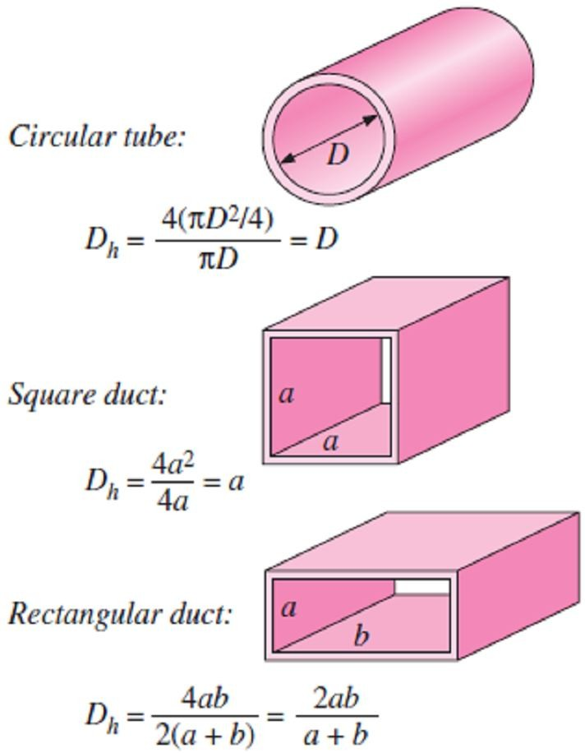
Chapter Six
Convection Heat Transfer
6.4.2.2- Laminar and Turbulent Flow in Tubes
Flow in a tube can be laminar or turbulent, depending on the flow conditions. Fluid flow is streamlined and thus laminar at low velocities, but turns turbulent as the velocity is increased beyond a critical value. Most pipe flows encountered in practice are turbulent. Laminar flow is encountered when highly viscous fluids such as oils flow in small diameter tubes or narrow passages. For flow in a circular tube, the Reynolds number is defined as;
_{Re =}  V_{m} D ₌ V_{m} D
☹(6.21)
❍ 
Where V_{m} is the mean fluid velocity, D is the diameter of the tube, and
ν is the kinematic viscosity of the fluid.
Note1- For flow through noncircular tubes, the Reynolds number as well as the Nusselt number and the friction factor are based on the hydraulic diameter D_{h} defined as Fig.(6.21);
D
₌ 4 A_{c}
☹(6.22)
h
p
Where A_{c} is the cross sectional area of the tube and p is its perimeter. The hydraulic diameter is defined such that it reduces to ordinary
diameter D for circular tubes since for circular tubes;
4 A
D_{h} = ^{c} =
4 ( D² / 4)
❐ D
= D
p
Note2- Practically, the flow in a tube will be laminar, transitional or
turbulent according to the value of Reynolds number as follow;
Fig.(6.21) The hydraulic diameter D_{h} = 4A_{c} /p is defined such that it reduces to ordinary diameter
for circular tubes
Re < 2300
2300 ≤ Re ≤ 10,000
Re >10,000
Laminar Flow Transitional Flow Turbulent Flow
6.4.2.3- The Entrance Region
6.4.2.3.a- The Hydrodynamic Entrance Region
Consider a fluid entering a circular tube at a uniform velocity, the following points will happen for the velocity profile;
The fluid particles in the layer in contact with the surface of the tube will come to a complete stop,
where this layer will also cause the fluid particles in the adjacent layers to slow down gradually as a result of friction.
To make up for this velocity reduction, the velocity of the fluid at the midsection of the tube will have to increase to keep the mass flow rate through the tube constant. As a result, a velocity
boundary layer develops along the tube.
The thickness of this boundary layer increases in the flow direction until the boundary layer reaches the tube center as shown in Fig.(6.22).
Note1- The region from the tube inlet to the point at which the boundary layer merges at the centerline
is called the hydrodynamic entrance region, and the length of this region is called the
hydrodynamic entry length L_{h}.
Note2- Flow in the entrance region is called hydrodynamically developing flow since this is the region where the velocity profile develops.
Note3- The region beyond the entrance region in which the velocity profile is fully developed and
remains unchanged, is called the hydrodynamically fully developed region.
Note4- The velocity profile in the fully developed region is parabolic in laminar flow and somewhat
flatter in turbulent flow due to eddy motion in radial direction.

Slide 16
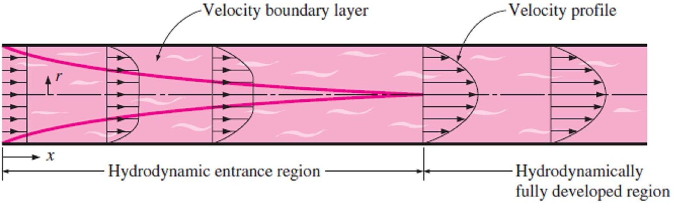
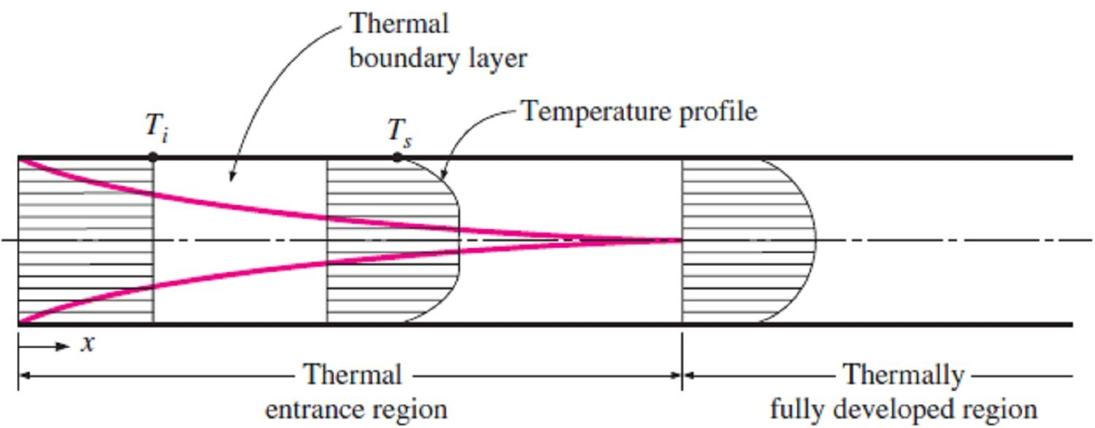
Chapter Six
Convection Heat Transfer
Fig.(6.22) The development of the velocity boundary layer in a tube
6.4.2.3.b- The Thermal Entrance Region
Now consider a fluid at a uniform temperature entering a circular tube whose surface is maintained at a different temperature, the following points will happen for the thermal profile of the flow;
The fluid particles in the layer in contact with the surface of the tube will assume the surface temperature. This will initiate convection heat transfer in the tube and the development of a
thermal boundary layer along the tube.
The thickness of this boundary layer also increases in the flow direction until the boundary layer reaches the tube center, as shown in Fig.(6.23).
Note1- The region of flow over which the thermal boundary layer develops and reaches the tube center
is called the thermal entrance region, and the length of this region is called the thermal entry length
L_{t}.
Note2- Flow in the thermal entrance region is called thermally developing flow since this is the region where the temperature profile develops.
Note3- The region beyond the thermal entrance region in which the dimensionless temperature profile
expressed as (T_{s} - T)/(T_{s} - T_{m}) remains unchanged is called the thermally fully developed region.
Fig.(6.23) The development of the thermal boundary layer in a tube
6.4.2.3.c- The Fully Developed Region
The region in which the flow is both hydrodynamically and thermally developed and thus both the velocity and dimensionless temperature profiles remain unchanged is called the fully developed region, That is;
- Hydrodynamically fully developed;
∂V (r, x) ₌ ₀
⇒ V = V (r) …(6.23.a)
∂ x
- Thermally fully developed;
∂ ⎡T_{s} (x) − T (r, x) ⎤
…(6.23.b)
∂ x ⎢ T (x) − T (x) ^{⎥ = 0}
⎣ s m ⎦
6.4.2.3.d- Evaluating The Entry Lengths
In laminar flow, the hydrodynamic and thermal entry lengths are given approximately as;
L_{h, la min ar} ≈ 0.05Re D
⎫⎪
L ≈ 0.05Re D = Pr L
h, la min ar ⎭
⎬⎪ ☹(6.24)
t , la min ar
In turbulent flow, the hydrodynamic entry length is much shorter, as expected, and its dependence on the Reynolds number is weaker. Therefore, the hydrodynamic and thermal entry lengths will be;
^{L}h, turbulent ^{≈ L}t , turbulent ^{≈ 10 D}
☹(6.25)

Slide 17
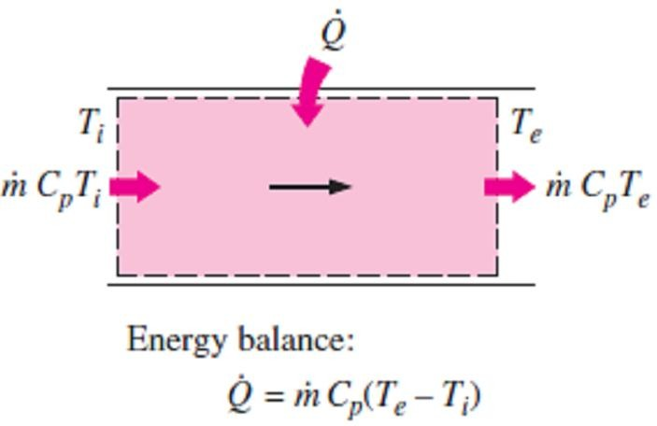
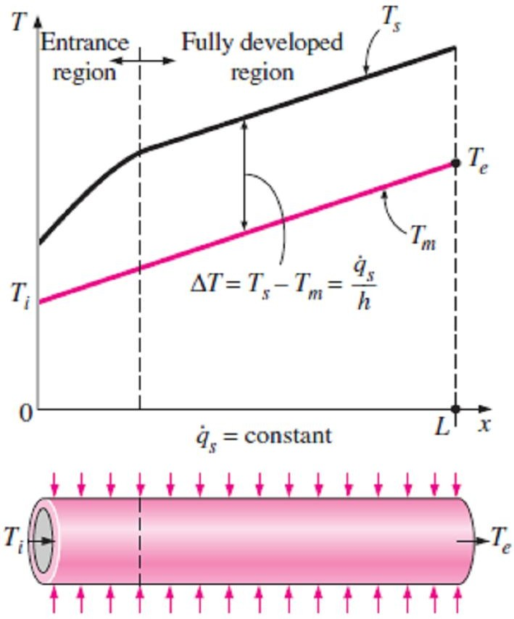
Chapter Six
Convection Heat Transfer
6.4.2.4- General Thermal Analysis
In the absence of any work interactions (such as electric resistance heating), the conservation of energy equation for the steady flow of a fluid in a tube can be expressed as in Fig.(6.24);
Q = m C_{p} (T_{e} − T_{i} ) (W ) ☹(6.26)
Where T_{i} and T_{e} are the mean fluid temperatures at the inlet and exit of the tube, respectively, while Q is the rate of heat transfer to or
from the fluid.
Note1- The temperature of a fluid flowing in a tube remains constant in the absence of any energy interactions through the walls.
Note2- The thermal conditions at the surface can be usually
Fig.(6.24) The development of the thermal boundary layer in a tube
approximated to be constant surface temperature (T_{s} = constant) or
constant surface heat flux ( q_{s} = constant), where the constant surface
temperature condition is realized when a phase change process such as boiling or condensation occurs at the outer surface of a tube, while the constant surface heat flux condition is realized when the tube is subjected to radiation or electric resistance heating uniformly from all directions.
6.4.2.4.a- Constant Surface Heat Flux ( q_{s} = constant)
In the case of q_{s} = constant, the rate of heat transfer can also be expressed as;
Q = q_{s} A_{s} = m C_{p} (T_{e} − T_{i} ) (W ) ☹(6.27.a)
where h_{x} is the local heat transfer coefficient and T_{s} and T_{m} are the surface and the mean fluid temperatures at that location. Therefore, the mean fluid temperature at the tube exit becomes;
T = T
q_{s} A_{s}
☹(6.27.b)
e i
m C
p
Note1- The mean fluid temperature increases linearly in the flow direction in the case of constant surface heat flux, since the surface area increases linearly in the flow direction (A_{s} is equal to the perimeter, which is constant, times the tube length).
Note2- The surface heat flux can be evaluated from;
q = h (T − T ) (W / m² ) ☹(6.28.a)
s x s m
Thus, the surface temperature in the case of constant surface heat flux can be determined from;
T = T
q_{s}
☹(6.28.b)
s m
h
x
Note3- In the fully developed region, the surface temperature T_{s} will also increase linearly in the flow direction since h is constant and thus (T_{s} - T_{m} = constant) as shown in Fig.(6.25).
6.4.2.4.b- Constant Surface Temperature (T_{s} = constant)
From Newton’s law of cooling, the rate of heat transfer to or from a fluid flowing in a tube can be expressed as;
Q = h A_{s} ΔT_{ave} = h A_{s} (T_{s} − T_{m} )_{ave} (W ) ☹(6.29)
where h is the average convection heat transfer coefficient and Fig.(6.25) Variation of the tube surface
∆T_{ave} is some appropriate average temperature difference between
and the mean fluid temperatures along the tube for the case of constant surface heat flux
the fluid and the surface.

Slide 18
Chapter Six Convection Heat Transfer
There are two suitable methods for expressing ∆T_{ave} as follow;
meth.1- In the constant surface temperature (T_{s} = const.) case, ∆T_{ave} can be expressed approximately
by the arithmetic mean temperature difference ∆T_{am} as;
ΔT_{ave} ≈ ΔT_{am}
₌ ΔT_{i} + ΔT_{e =} (T_{s} − T_{i} ) + (T_{s} − T_{e} ) _{= T −} T_{i} + T_{e}
2
= T_{s} − T_{b}
s
2 2
☹(6.30)
where T_{b} = (T_{i} + T_{e})/2 is the bulk mean fluid temperature, which is the arithmetic average of
the mean fluid temperatures at the inlet and the exit of the tube.
Note1- The arithmetic mean temperature difference ∆T_{am} is simply the average of the temperature differences between the surface and the fluid at the inlet and the exit of the tube. Note2- The present method is based on the assumption that the mean fluid temperature varies linearly along the tube, which is hardly ever the case when T_{s}=constant, because the mean temperature of the fluid T_{m} will increase in the flow direction as a result of heat transfer, therefore, we need a better method to evaluate ∆T_{am}.
meth.2- The energy balance on a differential control volume gives;
m C_{p} dT_{m} = h(T_{s} − T_{m} )dA_{s} ☹(6.31.a)
Where dT_{m} (which is the increase in its mean temperature) is expressred as dT_{m}= -d(T_{s} - T_{m}), since T_{s} is constant, while the differential surface area is dA_{s} = pdx, where p is the perimeter of the tube. Therefore, the relation above can be rearranged as;
d (T_{s} − T_{m} ) ₌ ₋ h p
(T_{s} − T_{m} ) m C_{p}
dx ☹(6.31.b)
Integrating from x = 0 (tube inlet where T_{m} = T_{i}) to x = L (tube exit where T_{m} = T_{e}) gives;
⎛ T_{s} − T_{e} ⎞ h A_{s}
ln⎜ ⎟ = − ☹(6.31.c)
T − T m C
⎝ s i ⎠
p
where A_{s} = pL is the surface area of the tube and h is the constant average convection heat transfer coefficient.
Solving above equation for m C_{p} , gives;
m C = −
h A_{s}
☹(6.31.d )
p
ln[(T − T ) (T − T )]
s e s i
But we note that the transferred heat is;
Q = m C_{p} (T_{e} − T_{i} ) (W ) ☹(6.31.e)
So, from Eqs.[(6.31.d)& (6.31.e)], we obtain;
Q = h A_{s} ΔT_{ln} ☹(6.32.a)
Where;
ΔT = −
T_{e} − T_{i} ΔT_{e} − ΔT_{i}
=
☹(6.32.b)
ln
ln[(T − T )] ln(ΔT ΔT )
T ) (T
s e s i e i
is the logarithmic mean temperature difference.
Note1- The terms ∆T_{i}=T_{s} -T_{i} and ∆T_{e}= T_{s} -T_{e} are the temperature differences between the surface and the fluid at the inlet and the exit of the tube, respectively.
Note2- From Eq.(6.31.c), the mean fluid temperature at the tube exit will be as follow;
( − h A_{s} m C_{p} )
T_{e} = T_{s} − (T_{s} − T_{i} ) e ☹(6.33)
Above relation can also be used to determine the mean fluid temperature T_{m}(x) at any location x by replacing (A_{s} = pL) by (px).

Slide 19
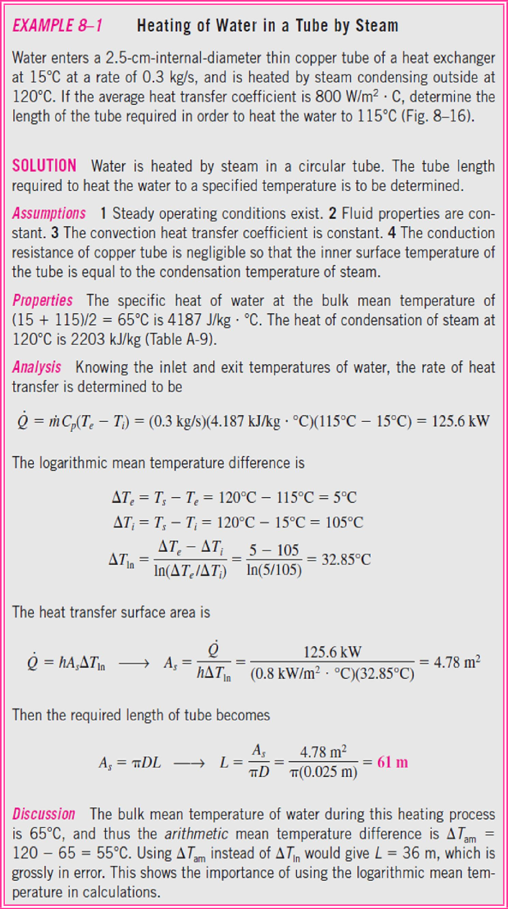
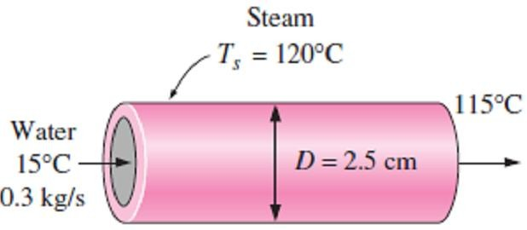
Chapter Six
Convection Heat Transfer
6.6-
as in Fig.(6.26).
Fig.(6.26) Schematic for Example- 6.6

Slide 20
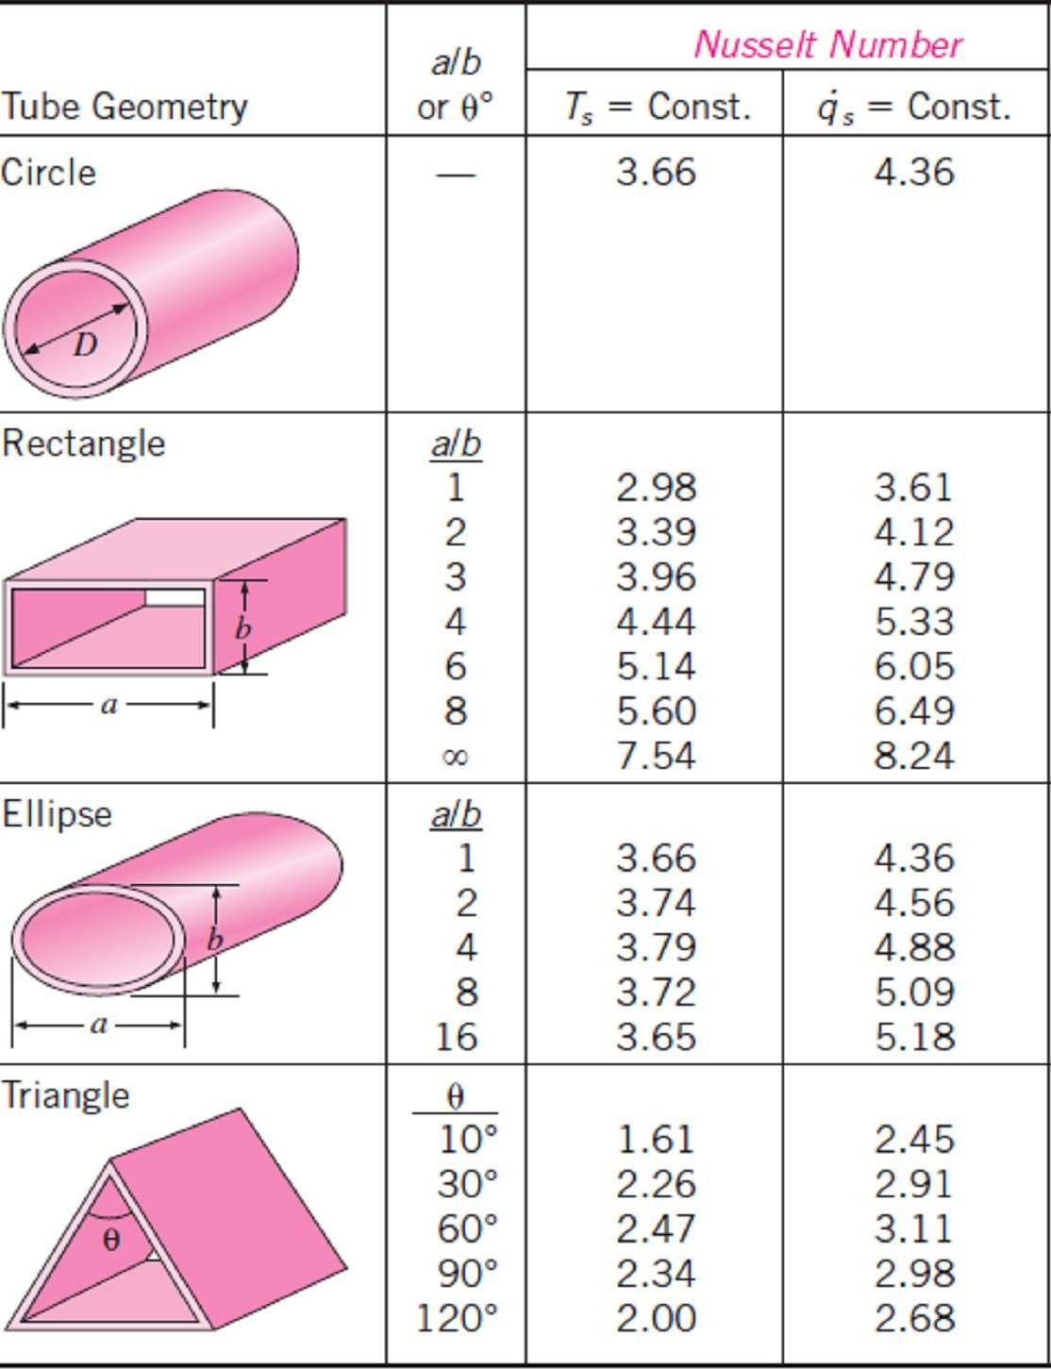
Chapter Six
Convection Heat Transfer
6.4.2.5- Laminar Flow in Tubes
6.4.2.5.a- Developing Laminar Flow in the Entrance Region
1- For a circular tube of length L subjected to constant surface temperature, the mean or average
Nusselt number for the thermal entrance region can be determined as follow;
Entry region, laminar:
Nu = 3.66 +
0.065(D / L) Re Pr
☹(6.34.a)
m
1 + 0.04[(D / L) Re Pr]^{2 / 3}
Note1- The average Nusselt number is larger at the entrance region, as expected, and it approaches asymptotically to the fully developed value of 3.66 when L → ∞.
Note2- When the difference between the surface and the fluid temperatures is large, it may be necessary to account for the variation of viscosity with temperature. So, the average Nusselt
number for developing laminar flow in a circular tube in that case can be determined from;
⎞0.14
Nu = 1.86 ⎜
⎛ Re Pr D ⎞^{1/ 3 ⎛ }
⎜ b ⎟
☹(6.34.b)
m
L
⎟
⎜  ⎟
⎝ ⎠
⎝
s ⎠
where all properties are evaluated at the bulk mean fluid temperature T_{b}=(T_{i} + T_{e})/2, except for μ_{s}
which is evaluated at the surface temperature T_{s}.
2- The average Nusselt number for the thermal entrance region of flow between isothermal parallel plates of length L is expressed as;
Entry region, laminar:
Nu = 7.54 +
0.03(D_{h} / L) Re Pr
☹(6.35)
m
1 + 0.016[(D / L) Re Pr]^{2 / 3}
h
where D_{h} is the hydraulic diameter, which is twice the spacing of the plates. This relation can be used for Re ≤ 2800.
6.4.2.5.b- Fully Developed Laminar Flow in Tubes
The Nusselt number relations are given in Table(6.3) for fully developed laminar flow in tubes of various cross sections.
Table (6.3) Nusselt number relations for fully developed laminar flow in tubes of various cross sections where (D_{h}= 4A_{c} /p, Re = V_{m} D_{h} /v, and Nu = hD_{h} /k)

Slide 21
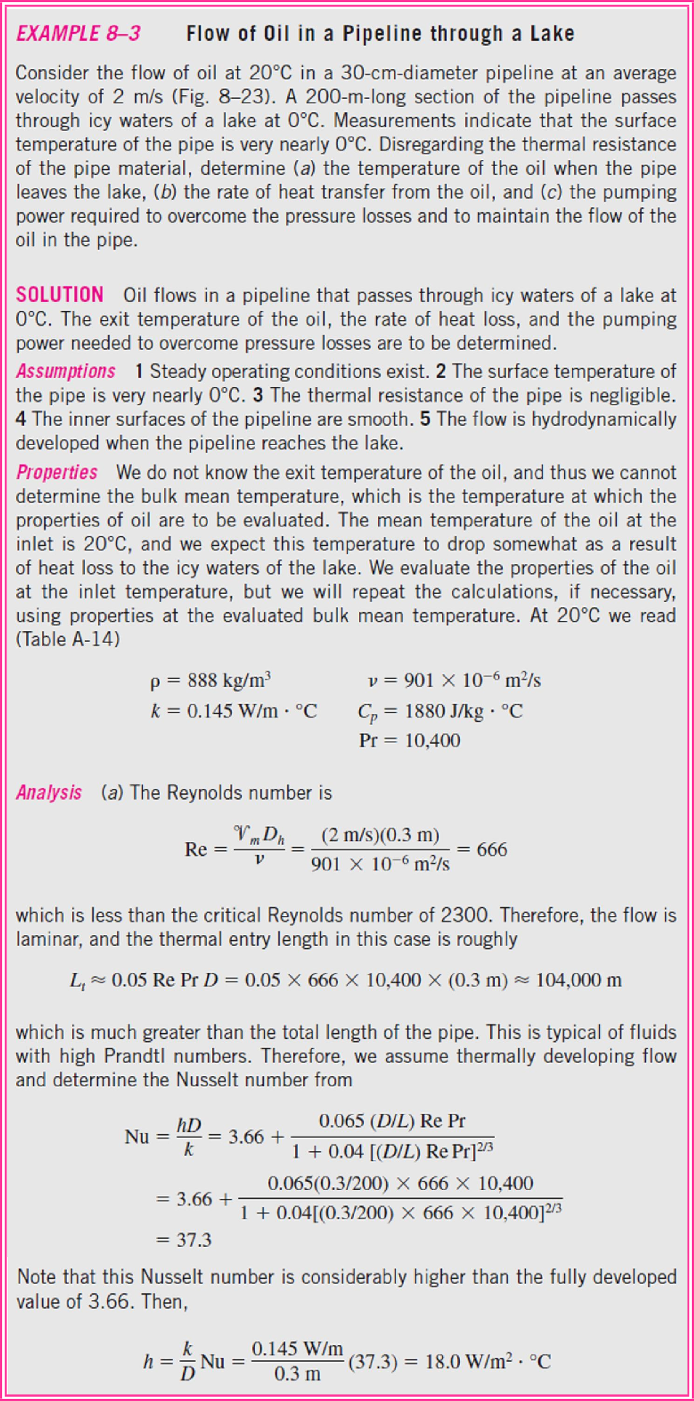
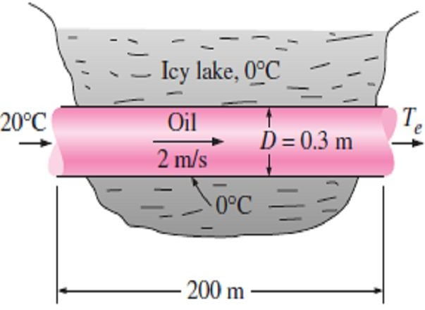
Chapter Six
Convection Heat Transfer
6.7-
Fig.(6.27).
.
Fig.(6.27) Schematic for Example- 6.7

Slide 22
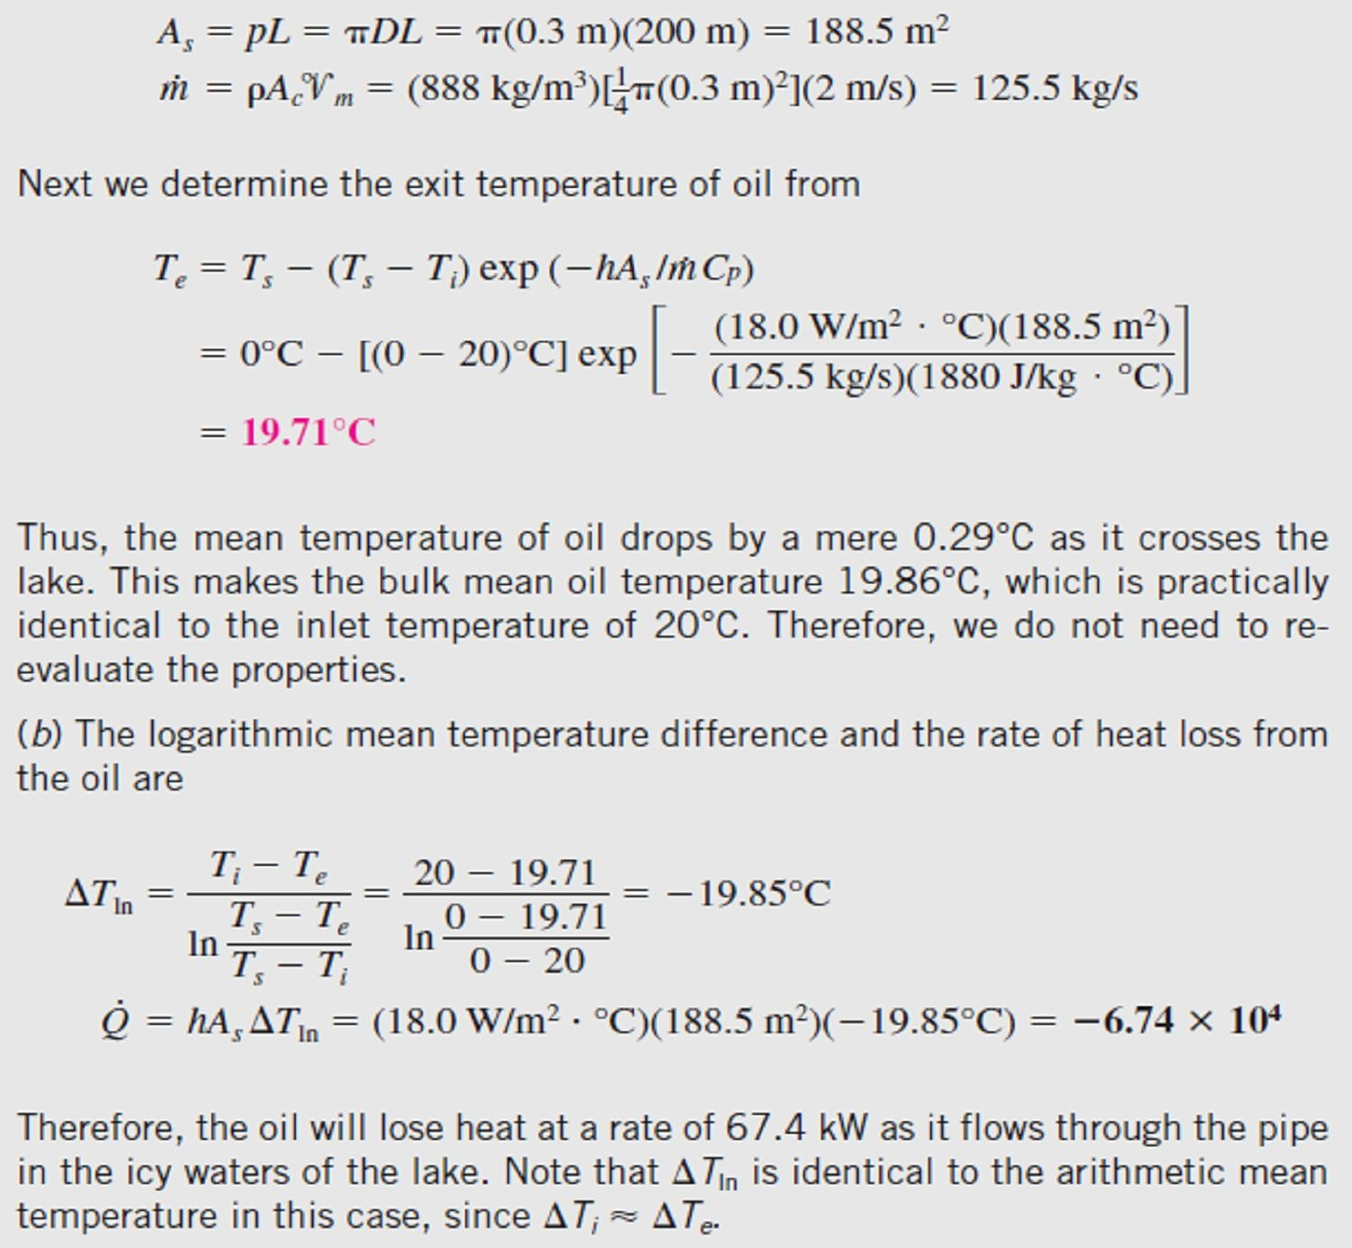
Chapter Six
Convection Heat Transfer
6.4.2.6- Turbulent Flow in Tubes
Most correlations for the heat transfer coefficients in turbulent flow are based on experimental studies because of the difficulty in dealing with turbulent flow theoretically.
Note1- For fully developed turbulent flow in smooth tubes, we can compute the Nusselt number by a relation known as the Colburn equation, as follow;
Nu = 0.023 Re^{0.8} Pr¹ ³
⎛ 0.7 ≤ Pr ≤ 160⎞
⎜ ☹(6.36.a)
⎝
Re > 10,000 ⎟
⎠
The accuracy of above equation can be improved by modifying it as;
Nu = 0.023Re^{0.8} Pr ^{n}
⎛ n = 0.3, for cooling ⎞
⎜ ⎟ ☹(6.36.b)
n = 0.4, for heating
⎝ ⎠
This equation is known as the Dittus–Boelter equation and it is preferred to the Colburn equation.
Note2- The fluid properties are evaluated at the bulk mean fluid temperature T_{b} = (T_{i} + T_{e})/2.
Note3- The relations above are not very sensitive to the thermal conditions at the tube surfaces and can
be used for both T_{s} = constant and q_{s} = constant cases.
Note4- The relations above do not apply to liquid metals because of their very low Prandtl numbers. For liquid metals (0.004 < Pr < 0.01), the following relations are recommended for (10⁴ < Re < 10⁶);
Liquid metals, T = const. ⇒ Nu = 4.8 + 0.0156 Re^{0.85} Pr ^{0.93} ☹(6.37.a)
s s
Liquid metals, q = const. ⇒ Nu = 6.3 + 0.0167 Re^{0.85} Pr ^{0.93}
☹(6.37.b)
s s
where the subscript (s) indicates that the Prandtl number is to be evaluated at the surface temperature. Note5- The entry lengths for turbulent flow are typically short, often just 10 tube diameters long, and thus the Nusselt number determined for fully developed turbulent flow can be used approximately for the entire tube.
Note6- The turbulent flow relations given above for circular tubes can also be used for noncircular tubes with reasonable accuracy by replacing the diameter D in the evaluation of the Reynolds number
by the hydraulic diameter D_{h} = 4A_{c} /p.

Slide 23
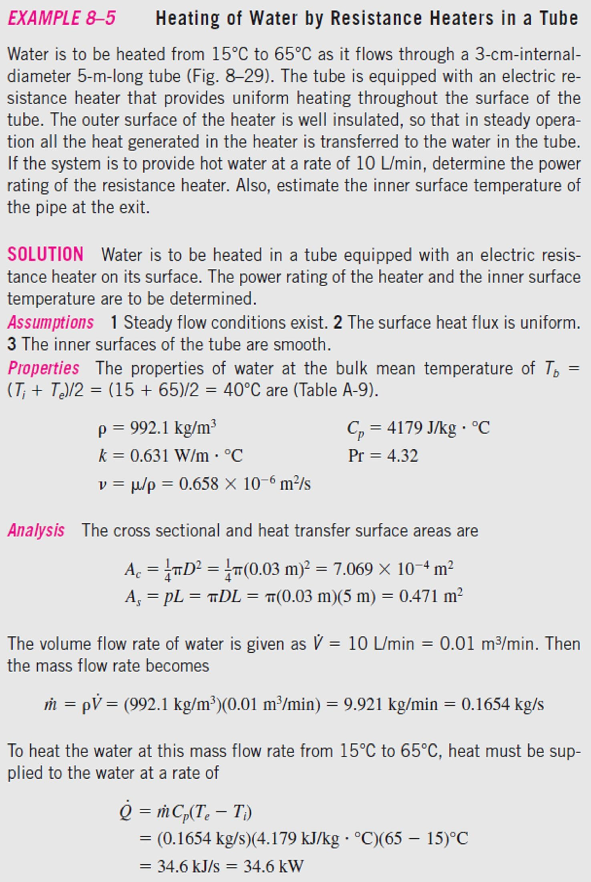
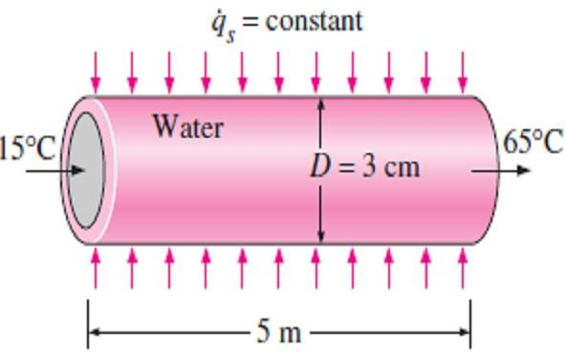
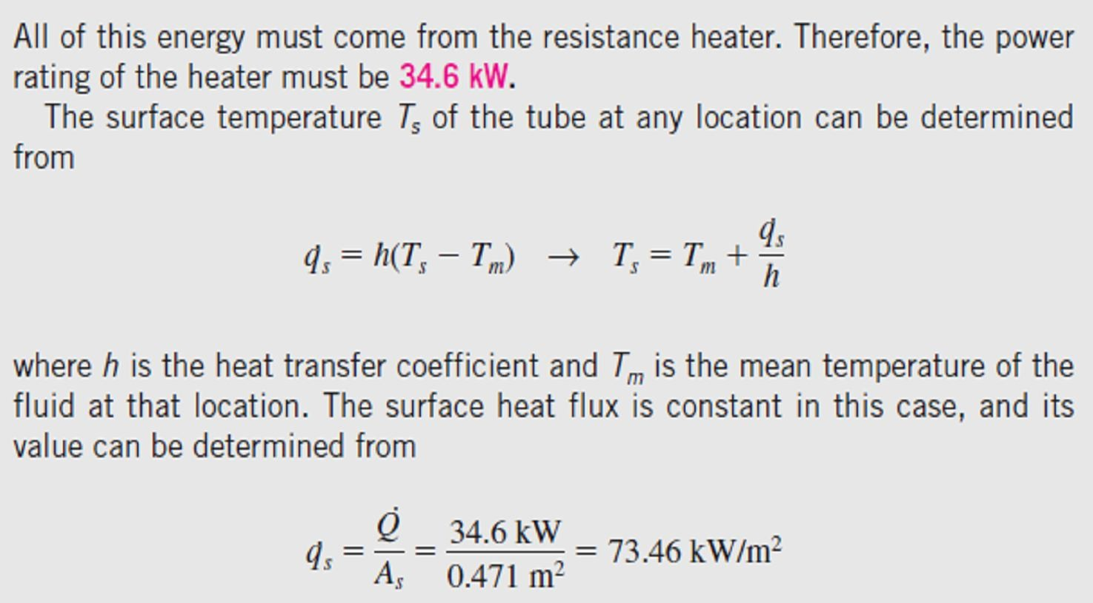
Chapter Six
Convection Heat Transfer
6.8-
Fig.(6.28).
Fig.(6.28) Schematic for Example- 6.8

Slide 24
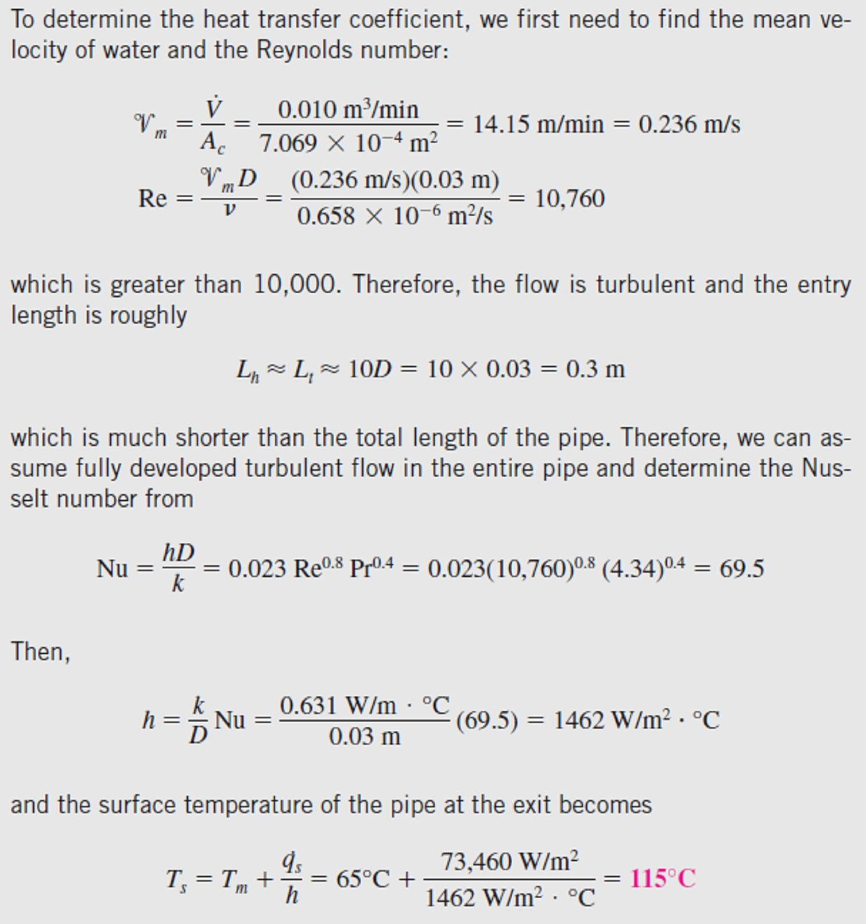
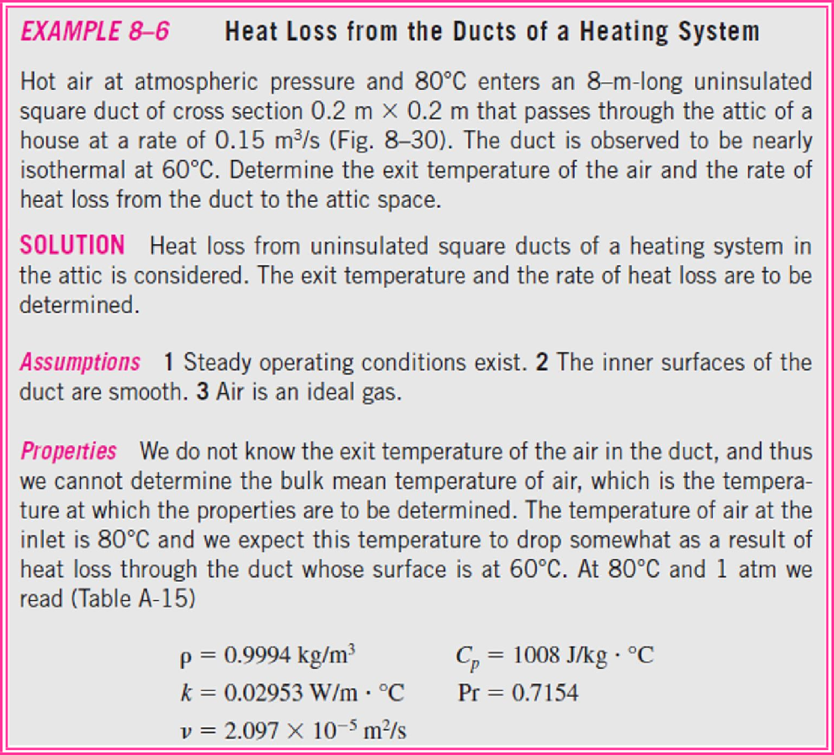
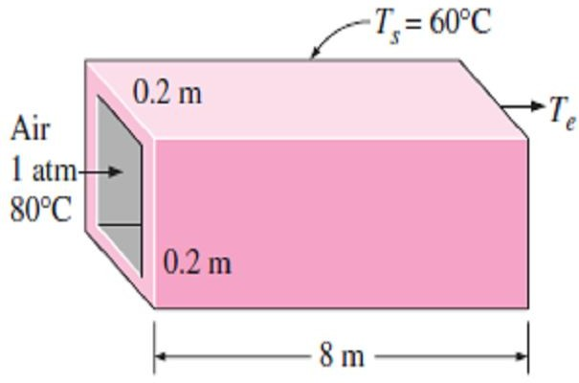
Chapter Six
Convection Heat Transfer
6.9-
Fig.(6.29).
Fig.(6.29) Schematic for Example- 6.9

Slide 25
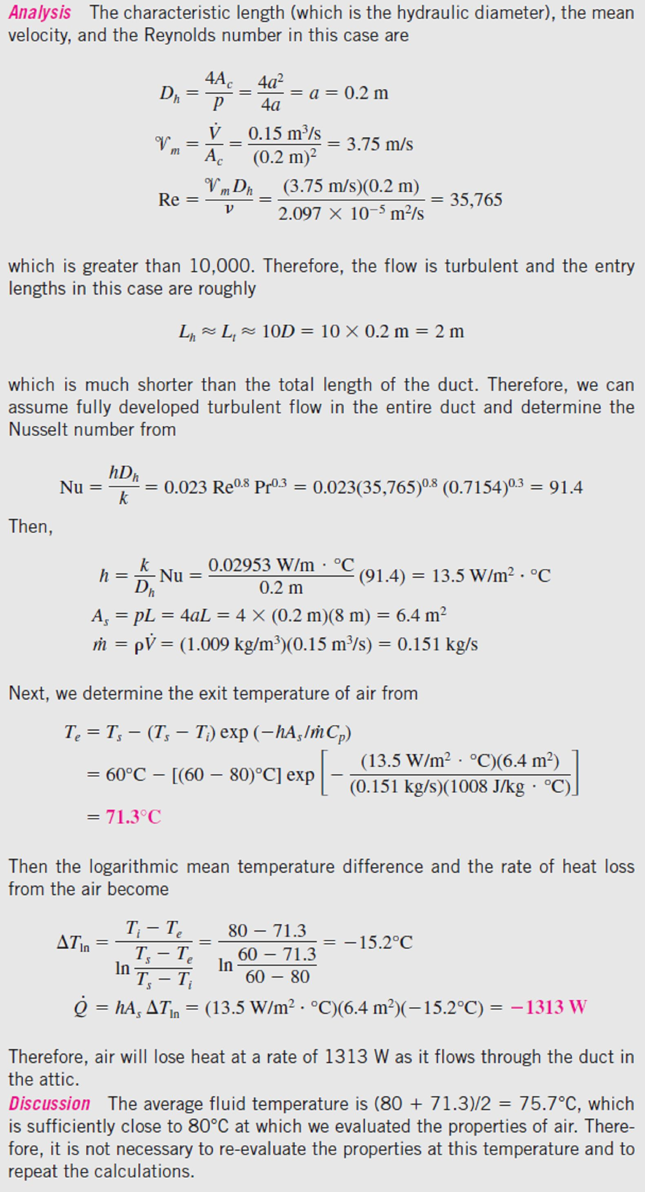
Chapter Six
Convection Heat Transfer

Slide 26



Chapter Six Convection Heat Transfer
6.5- Natural or Free Convection
When a surface is maintained in still fluid at a temperature higher or lower than that of the fluid, a layer of fluid adjacent to that surface will be heated or cooled. A density difference is created between this layer and the still fluid surrounding it. The density difference introduces a buoyant force causing flow of fluid near the surface as shown in
Figs.[(6.30.a)&(6.30.b)]. Heat transfer under such condition is known as natural or free convection heat transfer. Thus, free or natural convection is the process of heat transfer which occurs due to movement of the fluid particles by density changes associated with temperature differential in a fluid.
Fig.(6.30.a) The cooling of a boiled egg in a cooler environment by free convection
The main differences between the forced and natural convection can
be summarized in the following points;
In free convection, there is no need for an external device for moving the fluid, but the fluid is moved as a result of density difference from one location to another (the buoyancy effect), while in forced convection, that device must be existing for forcing the fluid to flow. Therefore, the free convection mode is used for heat transfer in simple devices.
The flow velocities encountered in free convection is lower compared to flow velocities in forced convection.
Because of the low flow velocities of free convection, therefore, the
values of heat transfer coefficient will be lower than its values in forced convection.
For a given rate of heat transfer, the required surface area in free
convection will be larger than its value in forced convection because
of the low heat transfer coefficient.
6.5.1- Velocity and Temperature Profiles in Free Convection
The velocity and temperature profiles for natural convection over a vertical hot plate are shown in Fig.(6.31), from these profiles we note the following points;
Fig.(6.30.b) The warming up of a cold drink in a warmer environment by free convection
As in forced convection, the thickness of the boundary layer increases in the flow direction.
Unlike forced convection, the fluid velocity is zero at the outer edge
of the velocity boundary layer as well as at the surface of the plate.
At the surface, the fluid temperature is equal to the plate temperature, and gradually decreases to the temperature of the surrounding fluid at a distance sufficiently far from the surface, as shown in the figure. In the case of cold surfaces, the shape of the velocity and temperature profiles remains the same but their direction is reversed.
6.5.2- Characteristic Parameters in Free Convection 6.5.2.1- Volume Expansion Coefficient
The property that represents the variation of the density of a fluid
with temperature at constant pressure is called the volume expansion coefficient β, which is as shown in Fig.(6.32) defined as follow;
_{ =} 1 ⎛ ∂ ⎞ ₌ ₋ 1 ⎛ ∂ ⎞
(1/ K ) ☹(1.38.a)
■ ⎜ ∂T ⎟  ⎜ ∂T ⎟
⎝ ⎠_{P}
⎝ ⎠ _{P}
Therefore, the volume expansion coefficient can be expressed as;
Fig.(6.31) Velocity and temperature profiles for natural convection flow over a hot vertical plate
1 Δ 1 ∞ − 
 ≈ − _{ ΔT} = − _{ T}
− T
(at P = const. ) ☹(1.38.b)
∞

Slide 27

Chapter Six Convection Heat Transfer
We can show easily that the volume expansion coefficient β of an ideal gas (P = ρRT) at a temperature T is equivalent to the inverse of the temperature as follow;

ideal gas
₌ 1
(1/ K ) ☹(1.39)
T
Where T is the absolute temperature.
Note- The buoyancy force is proportional to the density difference, which is proportional to the temperature difference at constant pressure. Therefore, the increasing in the temperature difference between the fluid adjacent to a hot (or cold) surface and the fluid away from it, will cause an increasing in
the buoyancy force and the natural convection currents, and thus, will
produce an increasing in the heat transfer rate.
6.5.2.2- The Equation of Motion and Grashof Number 6.5.2.2.a- The Equation of Motion in Natural Convection
The conservation equation of momentum in the x-direction for two- _{Fig.(6.32) The coefficient of}
dimensional flow is;
volume expansion is a measure of the change in volume with temperature at constant pressure
⎛ ∂u ∂u ⎞ ∂P ∂ ²u
⎜u + v ⎟ = − + 
2
−  g ☹(1.40.a)
∂x ∂y ∂x ∂y
⎝ ⎠
The x-momentum equation in the quiescent fluid outside the boundary layer can be obtained from the relation above as a special case by setting u = 0 and ρ = ρ∞, so, we have;
^{∂P∞} = − g ☹(1.40.b)
∂x
∞
The pressure in the boundary layer is equal to the pressure in the quiescent fluid. Therefore, P = P(x) =
P∞(x) and ∂P/∂x = ∂P∞ /∂x= -ρ∞ g. Substituting into Eq.(1.40.a), we have;
⎛ ∂u ∂u ⎞ ∂ ²u
⎜u + v ⎟ =  + ( −  )g
☹(1.40.c)
⎝
∂x ∂y
⎠
∂y
2 ∞
By substituting Eq.(1.38.b) into above equation we get;
⎛ ∂u ∂u ⎞ ∂²u
⎜u + v ⎟ =  + g  (T − T ) ☹(1.40.d )
∂x ∂y ∂y
2 ∞
⎝ ⎠
This is the equation that governs the fluid motion in the boundary layer due to the effect of buoyancy.
6.5.2.2.b- The Grashof Number
The governing equations of natural convection can be non-dimensionalized by dividing all dependent and independent variables by suitable constant quantities as follow;
X = ^{x} , Y = ^{y} , U = ^{u} , V =
v _{,  =} T − T∞
L L
_{V} * _{V} *
T − T
c c s ∞
Where L_{c} is the characteristic length, V* is an arbitrary reference velocity (which, from the definition of Reynolds number, is taken to be V*=Re_{L} ν/L_{c}). By substituting above quantity into Eq.(1.40.d), we have;
∂U ∂U 1 ∂ ²U ⎛ g  (T − T )L³ ⎞ 
∂X ∂Y Re ∂Y ²
U + V
=
_{+ ⎜} s ∞ c ⎟
☹(1.41)
⎜  2
⎟
Re
⎝ ⎠ ²
L
The dimensionless parameter in the brackets represents the natural convection effects, and is called the
Grashof number Gr_{L}, as follow;
L
g  (T − T )L³
_{GrL =} s ∞ c
☹ (1.42)
■ 2
Note1- The flow in natural convection is governed by the dimensionless Grashof number, which represents the ratio of the buoyancy force to the viscous force acting on the fluid as in Fig.(6.33).

Slide 28



Chapter Six Convection Heat Transfer
Note2- In natural convection (as in forced convection), the flow is subdivided into laminar and turbulent, where the smooth and parallel lines indicate that the flow is laminar, whereas the eddies and irregularities indicate that the flow is turbulent as shown in Fig.(6.34). The Grashof number provides the main criterion in determining whether the fluid flow is laminar or turbulent in natural convection.
Note3- When a surface is subjected to external flow, the problem involves both natural and forced convection. The relative importance of each mode
of heat transfer is determined by the value of the coefficient Gr_{L}/Re ² as
follow;
L
- If, Gr_{L}/Re ² <<1: Natural convection effects are negligible.
L
- If, Gr_{L}/Re ² >>1:
Free convection dominates and the forced
L
convection effects are negligible.
Fig.(6.33) The Grashof number
- If, Gr_{L}/Re ² ≈1: Both effects are significant and must be considered. is a ratio of the buoyancy force
L
to the opposing viscous force acting on the fluid
6.5.3- Natural Convection over Surfaces
The analytical solution of natural convection heat transfer on a surface is too complicated because it depends on the geometry of the surface as
well as its orientation. It also depends on the variation of temperature on the surface and the thermo-physical properties of the fluid involved. Therefore, with the exception of some simple cases, heat transfer relations in natural convection are based on experimental studies. The simple empirical correlations for the average Nusselt number Nu in natural convection have the following form;
Nu =
h L
n
n L
c
= C (Gr Pr) = C Ra
☹(1.43)
k
L
Where Ra_{L} is the Rayleigh number, which is the product of the Grashof
and Prandtl numbers as follow;
g  (T − T )L³
Ra_{L} = Gr_{L} Pr = ^{s ∞ c} Pr
☹(1.44)
■ 2
Fig.(6.34) Isotherms in natural convection over a hot plate
Note1- The constants C and n depend on the range of the Rayleigh
number which specifies geometry of the surface and the flow regime.
Note2- Simple relations for the average Nusselt number for various geometries are given in Table(6.4) according to the ranges of Rayleigh number in which the relation is applicable.
Note3- All fluid properties are to be evaluated at the film temperature T_{f} = (T_{s} +T∞)/2.
Note4- In the case of vertical plate (which is subjected to a constant surface heat flux), the rate of heat
transfer is known ( Q = q _{s} A_{s} ), but the surface temperature T_{s} is not constant and increases with height
along the plate. The Nusselt number relations for the constant surface temperature case [which is given in Table(6.4)] and those for constant surface heat flux case are nearly identical. Therefore, the relation
for isothermal plates can also be used for plates subjected to uniform heat flux and has the form;
2
⎧⎪ ⎫⎪
0.387 Ra^{1/ 6}
Nu = ⎨0.825 + ^{L} ⎬
☹(1.45.a)
[1 + (0.492 / Pr) ]
8 / 27
⎪⎩
9 / 16
⎪
⎭
In addition, the plate midpoint temperature T_{L / 2} is used for T_{s} in the evaluation of the film temperature, Rayleigh number, and the Nusselt number. Noting that h = q_{s} /(T_{L / 2} − T∞ ) , the average Nusselt number in this case can be expressed as;
Nu = ^{h L} =
q_{s} L
☹ (1.45.b)
k (T_{L / 2} − T∞ )
The midpoint temperature T_{L / 2} is determined by iteration so that the Nusselt numbers determined from Eqs.[(1.45.a) & (1.45.b)] match.

Slide 29

Chapter Six
Convection Heat Transfer
Table(6.4) Empirical correlations for the average Nusselt number for natural convection over surfaces

Slide 30



Chapter Six
Convection Heat Transfer
6.10-
(6.35).
Fig.
Fig.(6.35) Schematic for Example- 6.10
as in Fig.(6.36);
Fig.(6.36) Radiation heat transfer is usually comparable to natural convection in magnitude and should be considered in heat transfer analysis

Slide 31


Chapter Six
Convection Heat Transfer
6.11-
(6.37).
Fig.(6.37) Schematic for Example- 6.11

Slide 32

Chapter Six
Convection Heat Transfer

Slide 33


Chapter Six
Convection Heat Transfer
PROBLEMS
6.1- The local atmospheric pressure in Denver, Colorado (elevation 1610m), is 83.4kPa. Air at this pressure and at 30C° flows with a velocity of
6 m/s over a 2.5m × 8m flat plate whose
temperature is 120C°. Determine the rate of heat transfer from the plate if the air flows parallel to the (a) 8m-long side and (b) the 2.5m-side.
Answers: 18.1 kW, 12,92 kW 6.2- During a cold winter day, wind at 55km/h is blowing parallel to a 4m-high and 10m-long wall of a house. If the air outside is at 5C° and the surface temperature of the wall is 12C°, determine the rate of heat loss from that wall by convection. What would your answer be if the wind velocity was doubled?
Answers: 9081 W, 16,200 W
6.3- Consider a hot automotive engine, which can be approximated as a 0.5m-high, 0.40m-wide, and 0.8m-long rectangular block. The bottom surface of the block is at a temperature of 80C° and has an emissivity of 0.95. The ambient air is at 20C°, and the road surface is at 25C°. Determine the rate of heat transfer from the bottom surface of the engine block by convection and radiation as the car travels at a velocity of 80km/h. Assume the flow to be turbulent over the entire surface because of the constant agitation of the engine block.
Answers: 1363 W, 132 W, 1495 W
6.4- The forming section of a plastics plant puts out a continuous sheet of plastic that is 1.2m wide and 2mm thick at a rate of 15m/min. The temperature of the plastic sheet is 90C° when it is exposed to the surrounding air, and the sheet is subjected to air-flow at 30C° at a velocity of 3m/s on both sides along its surfaces normal to the direction of motion of the sheet. The width of the air cooling section is such that a fixed point on the plastic sheet passes through that section in 2s. Determine the rate of heat transfer from the plastic sheet to the air. Answer: 437 W
6.5- The top surface of the passenger car of a train moving at a velocity of 70km/h is 2.8m wide and 8m long. The top surface is absorbing solar radiation at a rate of 200 W/m², and the temperature of the ambient air is 30C°. Assuming the roof of the car to be perfectly insulated and the radiation heat exchange with the surroundings to be small relative to convection, determine the equilibrium temperature of the top surface of the car. Answer: 35.1C°
6.6- A 15cm×15cm circuit board dissipating 15W of power uniformly is cooled by air, which approaches the circuit board at 20C° with a velocity of 5m/s. Disregarding any heat transfer from the back surface of the board, determine the surface temperature of the electronic components
(a) at the leading edge and (b) at the end of the board. Assume the flow to be turbulent since the electronic components are expected to act as turbulators. Answers: 45.9C°, 47.0C°
6.7- Consider a refrigeration truck traveling at 55mph at a location where the air temperature is 80F°. The refrigerated compartment of the truck can be considered to be a 9ft-wide, 8ft-high, and 20ft-long rectangular box. The refrigeration system of the truck can provide 3tons of refrigeration (i.e., it can remove heat at a rate of 600Btu/min). The outer surface of the truck is coated with a low-emissivity material, and thus radiation heat transfer is very small. Determine the average temperature of the outer surface of the refrigeration compartment of the truck if the refrigeration system is observed to be operating at half the capacity. Assume the air flow over the entire outer surface to be turbulent and the heat transfer coefficient at the front and rear surfaces to be equal to that on side surfaces. Taking the following properties for the air (k=0.01481 Btu/h
·ft ·F°, ν = 0.1697×10⁻³ ft²/s, and Pr =0.729).
Answer: 77.7F°

Slide 34



Chapter Six
Convection Heat Transfer
6.8- Solar radiation is incident on the glass cover of a solar collector at a rate of 700W/m². The glass of collector absorbs 88 percent of the incident radiation on it and has an emissivity of
0.9. The entire hot water needs of a family can be provided by a single collector of 1.2m height and
2m width. The temperature of the glass cover of
the collector is measured to be 35C° on a day when the surrounding air temperature is 25C° and the wind is blowing at 30km/h. The effective sky temperature for radiation exchange between the glass cover and the open sky is -40C°. Water enters the tubes which attached to the absorber plate at a rate of 1kg/min. Assuming the back surface of the absorber plate to be heavily insulated and the only heat loss to occur through the glass cover, determine (a) the total rate of heat loss from the collector, (b) the collector efficiency, which is the ratio of the amount of heat transferred to the water to the solar energy incident on the collector, and (c) the temperature rise of water as it flows through the collector.
Answers: 1169 W, 0.209, 4.44C°
6.10 Repeat Prob.(6.9) assuming the heat sink to be black-anodized and thus to have an effective emissivity of 0.90. Note that in radiation calculations the base area (10cm×6.2cm) is to be used, not the total surface area.
Answer: 13.7 m/s 6.11- A long 8cm-diameter steam pipe whose external surface temperature is 90C° passes through some open area that is not protected against the winds. Determine the rate of heat loss from the pipe per unit of its length when the air is at 1atm pressure and 7C° and the wind is blowing across the pipe at a velocity of 50km/h.
Answer: 1130 W/m 6.12- A stainless steel ball (ρ = 8055 kg/m³, Cp= 480 J/kg ·C°) of diameter D = 15cm is removed from the oven at a uniform temperature of 350C°. The ball is then subjected to the flow of air at 1atm pressure and 30C° with a velocity of 6 m/s. The surface temperature of the ball eventually drops to 250C°. Determine the average heat transfer coefficient during this cooling process and estimate how long this process has taken.
Answers: 25.12 W/m² ·C°, 23.75 min
6.13- An average person generates heat at a rate of 84 W while resting. Assuming one-quarter of this heat is lost from the head and disregarding
6.9- A transformer that is 5cm high, 10cm long, and 6.2cm wide is to be cooled by attaching a
10cm×6.2cm polished aluminum heat sink
radiation, determine the average surface
(emissivity = 0.03) to its top surface. The heat
temperature of the head when it is not covered
sink has seven fins, which are 5mm high, 2mm thick, and 10cm long. A fan blows air at 25C° parallel to the passages between the fins. The heat sink is to dissipate 20 W of heat and the base temperature of the heat sink is not to exceed 60C°. Assuming the fins and the base plate to be nearly isothermal and the radiation heat transfer to be negligible, determine the minimum free- stream velocity the fan needs to supply to avoid
and is subjected to winds at 10C° and 35km/h. The head can be approximated as a 30cm-
diameter sphere. Answer: 12.7C°
6.14- A 6mm-diameter electrical transmission line carries an electric current of 50A and has a
resistance of 0.002ohm per meter length.
Determine the surface temperature of the wire
during a windy day when the air temperature is 10C° and the wind is blowing across the transmission line at 40km/h. Answer: 11.8C°
overheating. Answer: 15.83 m/s

Slide 35


Chapter Six
Convection Heat Transfer
6.18- A 10cm-diameter, 30cm-high cylindrical bottle contains cold water at 3Cº. The bottle is placed in windy air at 27Cº. The water temperature is measured to be 11Cº after 45min of cooling. Disregarding radiation effects and heat transfer from the top and bottom surfaces, estimate the average wind velocity.
Answer: 1.91 m/s
6.19- Air enters a 20cm-diameter 12m-long underwater duct at 50C° and 1atm at a mean velocity of 7 m/s, and is cooled by the water outside. If the average heat transfer coefficient is 85 W/m² ·C° and the tube temperature is nearly equal to the water temperature of 5C°, determine the exit temperature of air and the rate of heat transfer. Answers: 8.74C°, 10.6 kW
6.15- A heating system is to be designed to keep the wings of an aircraft cruising at a velocity of 900km/h above freezing temperatures during flight at 12,200m altitude where the atmospheric temperature and properties are (T_{a}=-55.4C°, k=0.02152 W/m ·C°, ν= 5.961×10⁻⁵ m²/s, and Pr
= 0.7422). Approximating the wing as a cylinder of elliptical cross section whose minor axis is
30cm and disregarding radiation, determine the
average convection heat transfer coefficient on the wing surface and the average rate of heat transfer per unit surface area.
6.20- Cooling water available at 10C° is used to condense steam at 30C° in the condenser of a power plant at a rate of 0.15 kg/s by circulating the cooling water through a bank of 5m-long and
2 2
Answers: 86.39 W/m ·C°, 4786 W/m
6.16- The components of an electronic system are located in a 1.5m-long horizontal duct whose cross section is 20cm × 20cm. The components in the duct are not allowed to come into direct contact with cooling air, and thus are cooled by air at 30C° flowing over the duct with a velocity of 200m/min. If the surface temperature of the duct is not to exceed 65C°, determine the total power rating of the electronic devices that can be
1.2cm-internal-diameter thin copper tubes.
Cooling water enters the tubes at a mean velocity of 4 m/s, and leaves at a temperature of 24C°. The tubes are nearly isothermal at 30C°. Determine the average heat transfer coefficient between the water and the tubes, and the number of tubes needed to achieve the indicated heat transfer rate in the condenser.
Answers: 12.1 kW/m² ·C°, 13.8
6.21- Combustion gases passing through a 3cm- internal-diameter circular tube are used to vaporize waste water at atmospheric pressure. Hot gases enter the tube at 115kPa and 250C° at a mean velocity of 5 m/s, and leave at 150C°. If the average heat transfer coefficient is 120 W/m²
C° and the inner surface temperature of the tube
is 110C°, determine the tube length, also find the rate of evaporation of water if the heat of vaporization of water at 100C° is 2257 kJ/kg.
Answers: 30.7cm, 0.442kg/h
6.22- Water is to be heated from 10C° to 80C° as it flows through a 2cm-internal-diameter, 7m- long tube. The tube is equipped with an electric resistance heater, which provides uniform heating throughout the surface of the tube. The outer surface of the heater is well insulated. If the system is to provide hot water at a rate of 8L/min, determine the power rating of the resistance heater. Also, estimate the inner surface temperature of the pipe
mounted into the duct. Answer: 640 W
6.17- Consider a 50cm-diameter and 95cm-long hot water tank. The tank is placed on the roof of a house. The water inside the tank is heated to 80Cº by a flat-plate solar collector during the day. The tank is then exposed to windy air at 18Cº with an average velocity of 40km/h during the night. Estimate the temperature of the tank after a 45min-period. Assume the tank surface to be at the same temperature as the water inside, and the heat transfer coefficient on the top and bottom surfaces to be the same as that on the side
surface.
Answer: 69.9 C°
at the exit.
Answers: 38,627 W, 113.3C°

Slide 36



Chapter Six
Convection Heat Transfer
6.23- Hot air at atmospheric pressure and 85C° enters a 10m-long uninsulated square duct of cross section 0.15m × 0.15m that passes through the attic of a house at a rate of 0.1 m³/s. The duct is observed to be nearly isothermal at 70C°. Determine the exit temperature of the air and the rate of heat loss from the duct to the air space in the attic. Answers: 75.7C°, 941 W
6.26- A 15cm×20cm circuit board whose
components are not allowed to come into direct
contact with air, is to be cooled by passing cool air through a 20cm-long channel of rectangular cross section 0.2cm×14cm drilled into the board. The heat generated by the electronic components is conducted across the thin layer of the board to the channel, where it is removed by air that enters the channel at 15C°. The heat flux at the top surface of the channel can be considered to be uniform, and heat transfer through other surfaces is negligible. If the velocity of the air at the inlet of the channel is not to exceed 4m/s and the surface temperature of the channel is to remain under 50C°, determine the maximum total power of the electronic components that can safely be mounted on this circuit board.
Answer: 24.7 W
6.24- Consider an air solar collector that is 1m wide and 5m long and has a constant spacing of 3cm between the glass cover and the collector plate. Air enters the collector at 30C° at a rate of
0.15 m³/s through the 1m-wide edge and flows
along the 5m-long passage way. If the average temperatures of the glass cover and the collector plate are 20C° and 60C°, respectively, determine
(a) the temperature rise of air as it flows through
the collector and (b) the net rate of heat transfer to the air in the collector.
Answers: 7.3C°, 1461 W
6.27- Air enters a 7m-long section of a duct of rectangular cross section 15cm×20cm at 50C° and an average velocity of 7m/s. If the walls of the duct are maintained at 10C°, determine (a) the outlet temperature of the air, and (b) the rate of heat transfer from the air.
Answers: (a) 34.2°C, (b) 3776 W 6.28- Hot water at 90C° enters a 15m section of a cast iron pipe (k =52 W/m ·C°) whose inner and outer diameters are 4 and 4.6cm, respectively, at an average velocity of 0.8 m/s. The outer surface of the pipe, whose emissivity is 0.7, is exposed to the cold air at 10C° in a basement, with a convection heat transfer coefficient of l5W/m²
C°. Taking the walls of the basement to be at
10C°, determine (a) the rate of heat loss from the water, and (b) the temperature at which the water leaves the basement. Answers: 3453 W, 89.1C°
6.29- Hot exhaust gases leaving a stationary diesel engine at 450C° enter a l5cm-diameter pipe at an average velocity of 3.6m/s. The surface temperature of the pipe is 180C°. Determine the pipe length if the exhaust gases are to leave the pipe at 250C° after transferring heat to water in a heat recovery unit. Use properties of air for
6.25- Consider the flow of oil at 10C° in a 40cm- diameter pipeline at an average velocity of 0.5 m/s. A 300m-long section of the pipeline passes
through icy waters of a lake at 0C°.
Measurements indicate that the surface
temperature of the pipe is very nearly 0C°.
Disregarding the thermal resistance of the pipe material, determine (a) the temperature of the oil when the pipe leaves the lake, and (b) the rate of heat transfer from the oil.
Answers: 9.68C°, 3.31 kW
exhaust gases.
144
Answer: 10.72m

Slide 37



Chapter Six
Convection Heat Transfer
6.30- A steam at 165C° condenses in the shell side of a heat exchanger over the tubes through which water flows. Water enters the 4cm- diameter, 14m-long tubes at 20C° at a rate of 0.8 kg/s. Determine the exit temperature of water and the rate of condensation of geothermal steam if the condensation heat of steam at 165C° is 2066.5 kJ/kg. Answers: 148.8C°, 0.204 kg/sec
6.31- A 10m-long section of a 6cm-diameter horizontal hot water pipe passes through a large room whose temperature is 22C°. If the temperature and the emissivity of the outer surface of the pipe are 65C° and 0.8, respectively, determine the rate of heat loss from the pipe by
(a) natural convection and (b) radiation.
Answers: 477.6 W, 468.4 W
6.32- Consider a wall-mounted power transistor that dissipates 0.18W of power in an environment at 35C°. The transistor is 0.45cm long and has a diameter of 0.4cm. The emissivity of the outer surface of the transistor is 0.1, and the average temperature of the surrounding surfaces is 25C°. Disregarding any heat transfer from the base surface, determine the surface temperature of the transistor. Use air properties at 100C°.
Answer: 183C°
loss from the cylindrical side surface of the pan to the surroundings by (a) natural convection and
(b) radiation. (c) If water is boiling at a rate of
2kg/h at 100C°, determine the ratio of the heat lost from the side surfaces of the pan to that by
the evaporation of water. The heat of
vaporization of water at 100C° is 2257 kJ/kg.
Answers: 46.2 W, 56.1 W, 0.082
6.35- Consider a 15cm×20cm circuit board (PCB) that has electronic components on one side. The board is placed in a room at 20C°. The heat loss from the back surface of the board is negligible. If the circuit board is dissipating 8W of power in steady operation, determine the average temperature of the hot surface of the board, assuming the board is (a) vertical, (b) horizontal with hot surface facing up, and (c) horizontal with hot surface facing down. Take the emissivity of the surface of the board to be 0.8 and assume the surrounding surfaces to be at the same temperature as the air in the room.
Answers: (a) 46.6C°, (b) 42.6C°, (c) 50.7C°
6.33- A 400W cylindrical resistance heater is 1m long and 0.5cm in diameter. The resistance wire is placed horizontally in a fluid at 20C°. Determine the outer surface temperature of the resistance wire in steady operation if the fluid is
(a) air and (b) water. Ignore any heat transfer by radiation. Use properties at 500C° for air and 40C° for water. Answers: 1211C°, 42.5C°
6.34- Water is boiling in a 12cm-deep pan with an outer diameter of 25cm that is placed on top of a heater. The ambient air and the surrounding surfaces are at a temperature of 25C°, and the emissivity of the outer surface of the pan is 0.95. Assuming the entire pan to be at an average
6.36- A manufacturer makes absorber plates that are 1.2m×0.8m in size for use in solar collectors. The back side of the plate is heavily insulated, while its front surface is coated with black chrome, which has an absorptivity of 0.87 for solar radiation and an emissivity of 0.09. Consider such a plate placed horizontally outdoors in calm air at 25C°. Solar radiation is incident on the plate at a rate of 700W/m². Taking the effective sky temperature to be 10C°, determine the equilibrium temperature of the
temperature of 98C°, determine the rate of heat
absorber plate.
Answer: 115.6C°

Slide 38




Chapter Six
Convection Heat Transfer
6.37- A thick fluid (such as asphalt) flows in a pipe which is often heated in order to reduce the viscosity of that fluid and thus to reduce the pumping costs. Consider the flow of such a fluid through a 100m-long pipe of outer diameter 30cm in calm ambient air at 0C°. The pipe is heated electrically, and a thermostat keeps the outer surface temperature of the pipe constant at 25C°. The emissivity of the outer surface of the pipe is 0.8, and the effective sky temperature is
-30C°, determine the power rating of the electric
resistance heater, in kW, that needs to be used. Also, determine the cost of electricity associated with heating the pipe during a 10h period under the above conditions if the price of electricity is 0.09$/kWh. Answers: 29.1 kW, 26.2$
6.39- A 1.5m-diameter, 5m-long cylindrical tank is initially filled with liquid propane, whose density is 581 kg/m³. The tank is exposed to the ambient air at 25C° in calm weather. The outer surface of the tank is polished so that the radiation heat transfer is negligible. Now a crack develops at the top of the tank, and the pressure inside drops to 1atm while the temperature drops to -42C°, which is the boiling temperature of propane at 1atm. The heat of vaporization of propane at 1atm is 425 kJ/kg. The propane is slowly vaporized as a result of the heat transfer from the ambient air into the tank, and the propane vapor escapes the tank at -42C° through the crack. Assuming the propane tank to be at about the same temperature as the propane inside at all times, determine how long it will take for the tank to empty if it is not insulated.
Answer: 56.4 hr
6.38- Consider a 1.2m×2m glass window with a thickness of 6mm, thermal conductivity k = 0.78 W/m ·C°, and emissivity ε=0.9. The room and the walls that face the window are maintained at 25C°, and the average temperature of the inner surface of the window is measured to be 5C°. If the temperature of the outdoors is -5C°, determine (a) the convection heat transfer coefficient on the inner surface of the window,
(b) the rate of total heat transfer through the window, and (c) the combined natural convection and radiation heat transfer coefficient on the outer surface of the window. Is it reasonable to neglect the thermal resistance of the glass in this case?
Answers: 3.915W/m²·C°, 422.2W, 20.35W/m²·C°
6.40- A 40cm-diameter, 110cm- high cylindrical hot water tank is located in the house bathroom (which is at 20C°) and surrounded with air from all sides. The surface temperature of the tank is measured to be 44C° and its emissivity is 0.4. Taking the surrounding surface temperature to be also 20C°, determine the rate of heat loss from all surfaces of the tank by natural convection and radiation.
Answers: 157.9W, 101.1W

